Slide 1
CS162
Operating Systems and
Systems Programming
Lecture 21
Filesystems 1: Performance,
Queueing Theory, Filesystem Design
April 9th, 2024
Prof. John Kubiatowicz
http://cs162.eecs.Berkeley.edu

Slide 2
Recall: Magnetic Disks
Track
Sector
Cylinders: all the tracks under the
head at a given point on all surfaces
Read/write data is a three-stage process:
  Seek time: position the head/arm over the proper track
  Rotational latency: wait for desired sector to rotate under r/w head
  Transfer time: transfer a block of bits (sector) under r/w head
Head
Cylinder
Platter
Disk Latency = Queueing Time + Controller time +
Seek Time + Rotation Time + Xfer Time
Software
Queue
(Device Driver)
Hardware
Controller
Media Time
(Seek+Rot+Xfer)
Request
Result

Slide 3
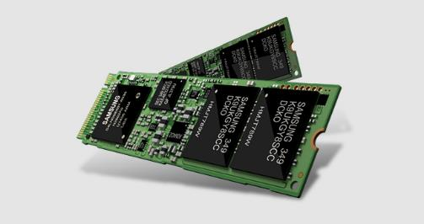
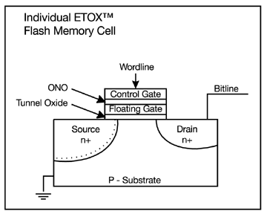
Recall: FLASH Memory
Samsung 2015:
512GB, NAND Flash
Like a normal transistor but:
  Has a floating gate that can hold charge
  To write: raise or lower wordline high enough to cause charges to tunnel
  To read: turn on wordline as if normal transistor
    presence of charge changes threshold and thus measured current
Two varieties:
  NAND: denser, must be read and written in blocks
  NOR: much less dense, fast to read and write
V-NAND: 3D stacking (Samsung claims 1TB possible in 1 chip)

Slide 4
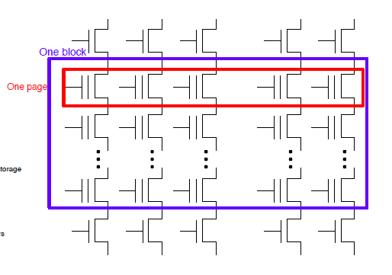
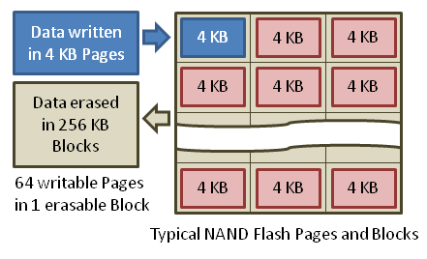
Flash Memory (Con’t)
Data read and written in page-sized chunks (e.g. 4K)
  Cannot be addressed at byte level
  Random access at block level for reads (no locality advantage)
  Writing of new blocks handled in order (kinda like a log)
Before writing, must be erased (256K block at a time)
  Requires free-list management
  CANNOT write over existing block (Copy-on-Write is normal case)

Slide 5
SSD Architecture – Reads
NAND
NAND
NAND
NAND
NAND
NAND
NAND
NAND
Host
Buffer
Manager
(software
Queue)
Flash
Memory
Controller
NAND
NAND
NAND
NAND
SATA
NAND
NAND
NAND
NAND
NAND
NAND
NAND
NAND
DRAM
NAND
NAND
  Read 4 KB Page: ~25 usec
  No seek or rotational latency
  Transfer time: transfer a 4KB page
    SATA: 300-600MB/s => ~4 x10³ b / 400 x 10⁶ bps => 10 us
  Latency = Queuing Time + Controller time + Xfer Time
  Highest Bandwidth: Sequential OR Random reads
NAND
NAND
NAND
NAND
NAND
NAND
NAND
NAND
NAND
NAND

Slide 6
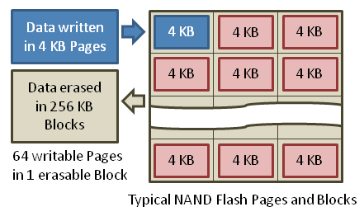
SSD Architecture – Writes
Writing data to NAND Flash is complex!
  Can only write empty pages in a block (~ 200μs)
  Erasing a block takes ~1.5ms
  Controller maintains pool of empty blocks by coalescing used pages (read, erase, write), also reserves some % of capacity
  Rule of thumb: writes 10x reads, erasure 10x writes
SSDs provide same interface as HDDs: read and write chunk (4KB) at a time
Why not just erase and rewrite new version of entire 256KB block?
  Erasure is very slow (milliseconds)
  Each block has a finite lifetime, can only be erased and rewritten about 10K times
  Heavily used blocks likely to wear out quickly
https://en.wikipedia.org/wiki/Solid-state_drive

Slide 7
Managing Writes: Flash Translation Layer
Maintain Flash Translation Layer (FTL) in SSD
  Layer of Indirection between OS and FLASH
  Map virtual block numbers (which OS uses) to physical page numbers (which flash mem.
  controller uses)
  Can now freely relocate data w/o OS knowing
FTL advantages/mechanism:
  Copy on Write: No need to immediately erase entire 256K block when modifying 4K page
    Don’t overwrite page when OS updates data
    Instead, write new version in a free page
    Update FTL mapping to point to new location
  Wear Levelling: Try to wear out NAND evenly
    SSD controller can assign mappings to spread workload across pages
  What to do with old versions of pages?
    Garbage Collection in background
    Erase blocks with old pages, add to free list
Operating
System
SSD
Flash Translation
Host
Interconnect
Host
Interface
Logical-physical
address translation
Flash
Controller
NAND
FLASH Chips
Garbage collection
Low-level
driver
Wear-leveling
File
System
Bad block
management
PCIe, SATA, SAS
SSD concurrency
Page allocation
Error
correction codes

Slide 8

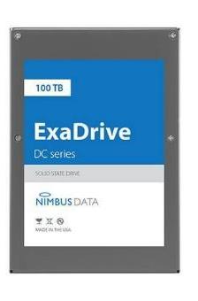
Some “Current” (large) 3.5in SSDs
Seagate Exos SSD: 15.36TB (2017)
  Dual 12Gb/s interface
  Seq reads 860MB/s
  Seq writes 920MB/s
  Random Reads (IOPS): 102K
  Random Writes (IOPS): 15K
  Price (Amazon): $5495 ($0.36/GB)
Nimbus SSD: 100TB (2019)
  Dual port: 12Gb/s interface
  Seq reads/writes: 500MB/s
  Random Read Ops (IOPS): 100K
  Unlimited writes for 5 years!
  Price: ~ $40K? ($0.4/GB)
    However, 50TB drive costs $12500 ($0.25/GB)

Slide 9
Amusing calculation:
Is a full Kindle heavier than an empty one?
Actually, “Yes”, but not by much
Flash works by trapping electrons:
  So, erased state lower energy than written state
Assuming that:
  Kindle has 4GB flash
  ½ of all bits in full Kindle are in high-energy state
  High-energy state about 10⁻¹⁵ joules higher
  Then: Full Kindle is 1 attogram (10⁻¹⁸gram) heavier
  (Using E = mc²)
Of course, this is less than most sensitive scale can measure (it can measure 10⁻⁹ grams)
Of course, this weight difference overwhelmed by battery discharge, weight from getting warm, ….
Source: John Kubiatowicz (New York Times, Oct 24, 2011)

Slide 10
SSD Summary
Pros (vs. hard disk drives):
  Low latency, high throughput (eliminate seek/rotational delay)
  No moving parts:
    Very light weight, low power, silent, very shock insensitive
  Read at memory speeds (limited by controller and I/O bus)
Cons
  Small storage (0.1-0.5x disk), expensive (3-20x disk)
    Hybrid alternative: combine small SSD with large HDD

Slide 11
SSD Summary
Pros (vs. hard disk drives):
  Low latency, high throughput (eliminate seek/rotational delay)
  No moving parts:
    Very light weight, low power, silent, very shock insensitive
  Read at memory speeds (limited by controller and I/O bus)
Cons
  Small storage (0.1-0.5x disk), expensive (3-20x disk)
    Hybrid alternative: combine small SSD with large HDD
  Asymmetric block write performance: read pg/erase/write pg
    Controller garbage collection (GC) algorithms have major effect on performance
  Limited drive lifetime
    1-10K writes/page for MLC NAND
    Avg failure rate is 6 years, life expectancy is 9–11 years
These are changing rapidly!
No longer true!

Slide 12

Administrivia (4/9/2024)
Midterm 3: Thursday April 25th
  All topics up to an including lecture on the 23rd
  3 sheets of notes, double-sided
Extra (fun!) lecture on Tuesday April 30th
  Topics TBA
Class attendance: No credit for people who use the same photo!
Data4All@Berkeley: This Friday!
  Friday 4/12, 12:00-1:00 in Soda 510
  Undergraduate or Masters students interested in Systems broadly defined (DB, Arch, Sec, Networking, Systems, etc.) who identify as an URM in Computer Science
  Come by for free lunch to meet fellow interested students
  Talk to relevant faculty, discuss possible classes, research opportunities in systems, as well as the best pizza topping!
https://tinyurl.com/3r3cj3ya

Slide 13
Ways of Measuring Performance: Times (s) and Rates (op/s)
Latency – time to complete a task
  Measured in units of time (s, ms, us, …, hours, years)
Response Time - time to initiate and operation and get its response
  Able to issue one that depends on the result
  Know that it is done (anti-dependence, resource usage)
Throughput or Bandwidth – rate at which tasks are performed
  Measured in units of things per unit time (ops/s, GFLOP/s)
Start up or “Overhead” – time to initiate an operation
Most I/O operations are roughly linear in b bytes
  Latency(b) = Overhead + b/TransferCapacity
Performance???
  Operation time (4 mins to run a mile…)
  Rate (mph, mpg, …)

Slide 14
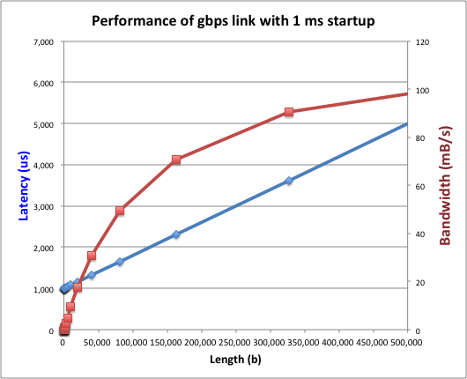
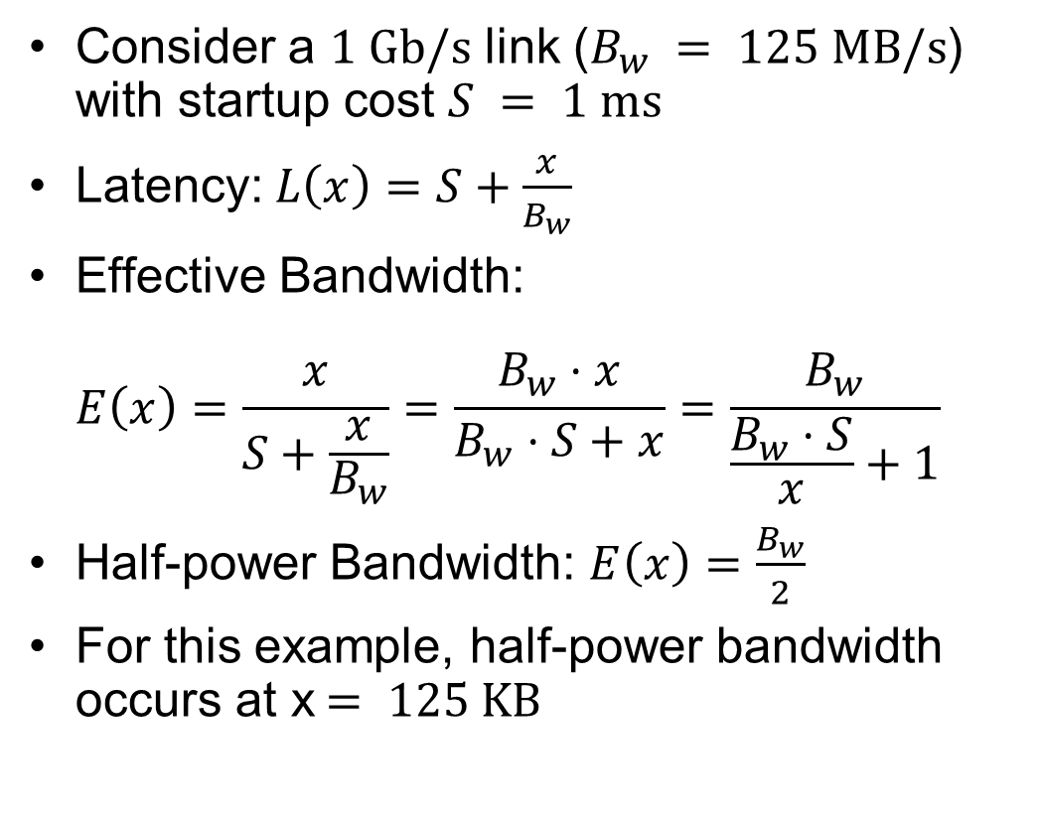
Example: Overhead in Fast Network
Consider a $1 \text{Gb}\text{/}\text{s}$ link ($B_{w} = 125 \text{MB}\text{/}\text{s}$) with startup cost $S = 1 \text{ms}$
Latency:$L\left(x\right)=S+\frac{x}{B_{w}}$
Effective Bandwidth:
$E\left(x\right)=\frac{x}{S+\frac{x}{B_{w}}}=\frac{B_{w}⋅x}{B_{w}⋅S+x}=\frac{B_{w}}{\frac{B_{w}⋅S}{x}+1}$
Half-power Bandwidth: $E\left(x\right)=\frac{B_{w}}{2}$
For this example, half-power bandwidth occurs at x$= 125 \text{KB}$
Length (x)

Slide 15
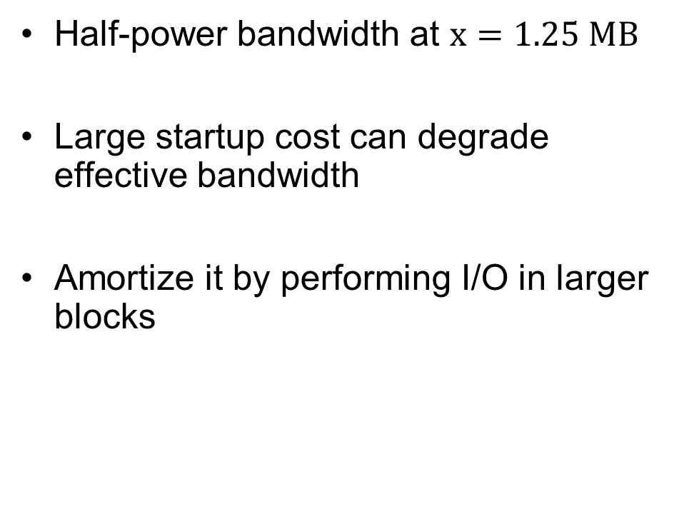
Example: 10 ms Startup Cost (e.g., Disk)
Half-power bandwidth at $x=1.25 \text{MB}$
Large startup cost can degrade effective bandwidth
Amortize it by performing I/O in larger blocks
  Half-power x = 1,250,000 bytes!
Length (x)

Slide 16
What Determines Peak BW for I/O?
Bus Speed
  PCI-X: 1064 MB/s = 133 MHz x 64 bit (per lane)
  ULTRA WIDE SCSI: 40 MB/s
  Serial Attached SCSI & Serial ATA & IEEE 1394 (firewire): 1.6 Gb/s full duplex (200 MB/s)
  USB 3.0 – 5 Gb/s
  Thunderbolt 3 – 40 Gb/s
Device Transfer Bandwidth
  Rotational speed of disk
  Write / Read rate of NAND flash
  Signaling rate of network link
Whatever is the bottleneck in the path…

Slide 17
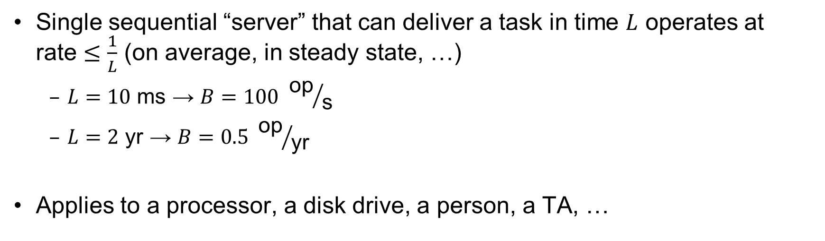
Sequential Server Performance
L
L
L
L
…
L
time
Single sequential “server” that can deliver a task in time $L$ operates at
rate $≤\frac{1}{L}$ (on average, in steady state, …)
  $L=10 \text{ms}$ → $B=100 {\text{op}}/{\text{s}}$
  $L=2 \text{yr}$ → $B=0.5 {\text{op}}/{\text{yr}}$
Applies to a processor, a disk drive, a person, a TA, …

Slide 18
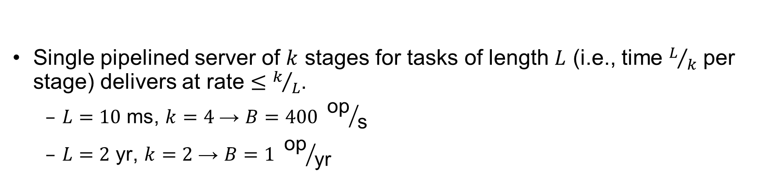
Single Pipelined Server
L
L
divided over distinct resources
logical operation
L
L
L
L
L
L
L
…
time
Single pipelined server of $k$ stages for tasks of length $L$ (i.e., time $L/k$ per stage) delivers at rate $≤k/L$.
  $L=10 \text{ms}$, $k=4$ → $B=400 {\text{op}}/{\text{s}}$
  $L=2 \text{yr}$, $k=2$ → $B=1 {\text{op}}/{\text{yr}}$

Slide 19



Example Systems “Pipelines”
I/O Processing
File
System
Upper Driver
Lower Driver
User Process
syscall
Communication
Anything with queues between operational process behaves roughly “pipeline like”
Important difference is that “initiations” are decoupled from processing
  May have to queue up a burst of operations
  Not synchronous and deterministic like in 61C

Slide 20
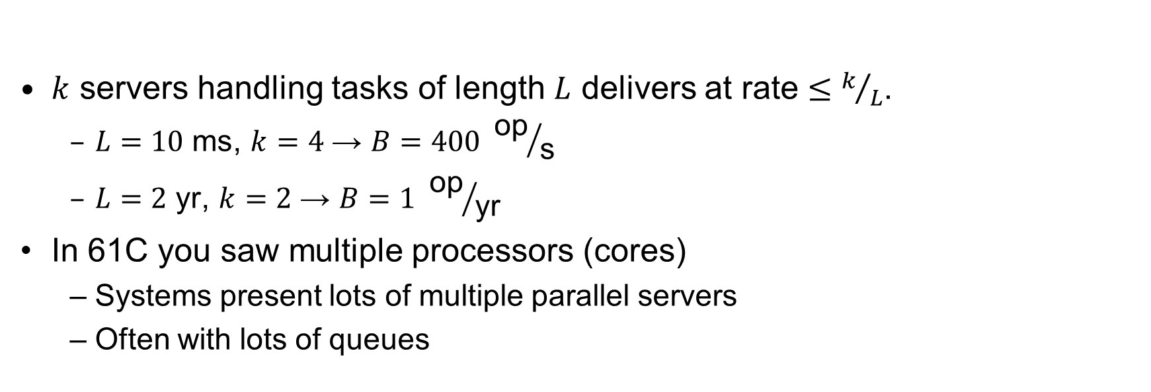
Multiple Servers
L
…
k
$k$ servers handling tasks of length $L$ delivers at rate $≤k/L$.
  $L=10 \text{ms}$, $k=4$ → $B=400 {\text{op}}/{\text{s}}$
  $L=2 \text{yr}$, $k=2$ → $B=1 {\text{op}}/{\text{yr}}$
In 61C you saw multiple processors (cores)
  Systems present lots of multiple parallel servers
  Often with lots of queues

Slide 21

Example Systems “Parallelism”
I/O Processing
syscall
File
System
Upper Driver
Lower Driver
User Process
User Process
User Process
Communication
Parallel Computation, Databases, …

Slide 22
I/O Performance
300
Response
Time (ms)
Controller
User
Thread
I/O
device
200
Queue
[OS Paths]
100
Response Time = Queue + I/O device service time
0
Performance of I/O subsystem
  Metrics: Response Time, Throughput
  Effective BW per op = transfer size / response time
    EffBW(n) = n / (S + n/B) = B / (1 + SB/n )
0%
100%
Throughput (Utilization)
(% total BW)
# of ops
time per op
Fixed overhead

Slide 23
I/O Performance
300
Response
Time (ms)
Controller
User
Thread
I/O
device
200
Queue
[OS Paths]
100
Response Time = Queue + I/O device service time
0
Performance of I/O subsystem
  Metrics: Response Time, Throughput
  Effective BW per op = transfer size / response time
    EffBW(n) = n / (S + n/B) = B / (1 + SB/n )
  Contributing factors to latency:
    Software paths (can be loosely modeled by a queue)
    Hardware controller
    I/O device service time
Queuing behavior:
  Can lead to big increases of latency as utilization increases
  Solutions?
0%
100%
Throughput (Utilization)
(% total BW)

Slide 24
A Simple Deterministic World
arrivals
Queue
Server
departures
T_{Q}
T_{S}
T_{A}
T_{A}
T_{A}
T_{q}
T_{S}
Assume requests arrive at regular intervals, take a fixed time to process, with plenty of time between …
Service rate (μ = 1/T_{S}) - operations per second
Arrival rate: (λ = 1/T_{A}) - requests per second
Utilization: U = λ/μ , where λ < μ
Average rate is the complete story

Slide 25
A Ideal Linear World
Saturation
1
1
Delivered Throughput
Delivered Throughput
Empty Queue
Unbounded
0
1
0
1
Offered Load (T_{S}/T_{A})
Offered Load (T_{S}/T_{A})
Queue delay
Queue delay
time
time
What does the queue wait time look like?
  Grows unbounded at a rate ~ (T_{s}/T_{A}) till request rate subsides

Slide 26
A Bursty World
arrivals
Queue
Server
departures
T_{Q}
T_{S}
Arrivals
Q depth
Server
Requests arrive in a burst, must queue up till served
Same average arrival time, but almost all of the requests experience large queue delays
Even though average utilization is low

Slide 27
So how do we model the burstiness of arrival?
Elegant mathematical framework if you start with exponential distribution
  Probability density function of a continuous random variable with a mean of 1/λ
  f(x) = λe^{-λx}
  “Memoryless”
Likelihood of an event occurring is independent of how long we’ve been waiting
mean arrival interval (1/λ)
Lots of short arrival intervals (i.e., high instantaneous rate)
Few long gaps (i.e., low instantaneous rate)
x (λ)

Slide 28
Background:
General Use of Random Distributions
Mean
(m)
Server spends variable time (T) with customers
  Mean (Average) m = Σp(T)×T
  Variance (stddev²) σ² = Σp(T)×(T-m)² = Σp(T)×T²-m²
  Squared coefficient of variance: C = σ²/m²
  Aggregate description of the distribution
Important values of C:
  No variance or deterministic ⇒ C=0
  “Memoryless” or exponential ⇒ C=1
    Past tells nothing about future
    Poisson process – purely or completely random process
    Many complex systems (or aggregates)
    are well described as memoryless
  Disk response times C ≈ 1.5 (majority seeks < average)
σ
Distribution
of service times
mean
Memoryless

Slide 29
Introduction to Queuing Theory
Controller
Arrivals
Disk
Departures
Queue
Queuing System
What about queuing time??
  Let’s apply some queuing theory
  Queuing Theory applies to long term, steady state behavior ⇒ Arrival rate = Departure rate
Arrivals characterized by some probabilistic distribution
Departures characterized by some probabilistic distribution
Notes:
Old and New Testament by Kleirock
Regret skipping as grad student

Slide 30
Little’s Law
N
arrivals
departures
λ
L
In any stable system
  Average arrival rate = Average departure rate
The average number of jobs/tasks in the system (N) is equal to arrival time / throughput (λ) times the response time (L)
  N (jobs) = λ (jobs/s) x L (s)
Regardless of structure, bursts of requests, variation in service
  Instantaneous variations, but it washes out in the average
  Overall, requests match departures

Slide 31
Example
L = 5
λ = 1
L = 5
N = 5 jobs
Jobs
0
1
2
3
4
5
6
7
8
9
10
11
12
13
14
15
16
time
A: N = λ x L
E.g., N = λ x L = 5

Slide 32
Little’s Theorem: Proof Sketch
N
arrivals
departures
λ
Job i
L(i) = response time of job i
N(t) = number of jobs in system
at time t
L
N(t)
time
L(1)
T

Slide 33
Little’s Theorem: Proof Sketch
N
arrivals
departures
λ
Job i
L(i) = response time of job i
N(t) = number of jobs in system
at time t
L
N(t)
time
T
What is the system occupancy, i.e., average
number of jobs in the system?

Slide 34
Little’s Theorem: Proof Sketch
N
arrivals
departures
λ
Job i
L(i) = response time of job i
N(t) = number of jobs in system
at time t
S(i) = L(i) * 1 = L(i)
L
S(k)
N(t)
S(2)
S(1)
time
T
S = S(1) + S(2) + … + S(k) = L(1) + L(2) + … + L(k)

Slide 35
Little’s Theorem: Proof Sketch
N
arrivals
departures
λ
Job i
L(i) = response time of job i
N(t) = number of jobs in system
at time t
S(i) = L(i) * 1 = L(i)
L
N(t)
S= area
time
T
Average occupancy (N_{avg}) = S/T

Slide 36
Little’s Theorem: Proof Sketch
N
arrivals
departures
λ
Job i
L(i) = response time of job i
N(t) = number of jobs in system
at time t
S(i) = L(i) * 1 = L(i)
L
S(k)
N(t)
S(2)
S(1)
time
T
N_{avg} = S/T = (L(1) + … + L(k))/T

Slide 37
Little’s Theorem: Proof Sketch
N
arrivals
departures
λ
Job i
L(i) = response time of job i
N(t) = number of jobs in system
at time t
S(i) = L(i) * 1 = L(i)
L
S(k)
N(t)
S(2)
S(1)
time
T
N_{avg} = (L(1) + … + L(k))/T = (N_{total}/T)*(L(1) + … + L(k))/N_{total}

Slide 38
Little’s Theorem: Proof Sketch
N
arrivals
departures
λ
Job i
L(i) = response time of job i
N(t) = number of jobs in system
at time t
S(i) = L(i) * 1 = L(i)
L
S(k)
N(t)
S(2)
S(1)
time
T
N_{avg} = (N_{total}/T)*(L(1) + … + L(k))/N_{total} = λ_{avg} × L_{avg}

Slide 39
Little’s Theorem: Proof Sketch
N
arrivals
departures
λ
Job i
L(i) = response time of job i
N(t) = number of jobs in system
at time t
S(i) = L(i) * 1 = L(i)
L
S(k)
N(t)
S(2)
S(1)
time
T
N_{avg} = λ_{avg} × L_{avg}

Slide 40

Little’s Law Applied to a Queue
When Little’s Law applied to a queue, we get:
Average Arrival Rate
$$L_{Q}=λT_{Q}$$
Average length of the queue
Average time “waiting”
in queue

Slide 41
A Little Queuing Theory: Computing T_{Q}
Assumptions:
  System in equilibrium; No limit to the queue
  Time between successive arrivals is random and memoryless
Parameters that describe our system:
  λ: mean number of arriving customers/second
  T_{ser}: mean time to service a customer (“m1”)
  C: squared coefficient of variance = σ²/m1²
  μ: service rate = 1/T_{ser}
  u: server utilization (0≤u≤1): u = λ/μ = λ × T_{ser}
Results:
  Memoryless service distribution (C = 1): (an “M/M/1 queue”):
    T_{q} = T_{ser} x u/(1 – u)
  General service distribution, 1 server (an “M/G/1 queue”):
    T_{q} = T_{ser} x ½(1+C) x u/(1 – u)
Why does response/queueing delay grow unboundedly even though the utilization is < 1 ?
Queue
Server
300
Response
Time (ms)
Arrival Rate
λ
Service Rate
μ=1/T_{ser}
200
100
0
0%
100%
Throughput (Utilization)
(% total BW)

Slide 42
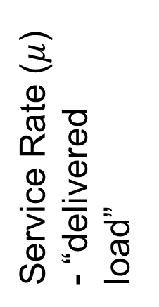
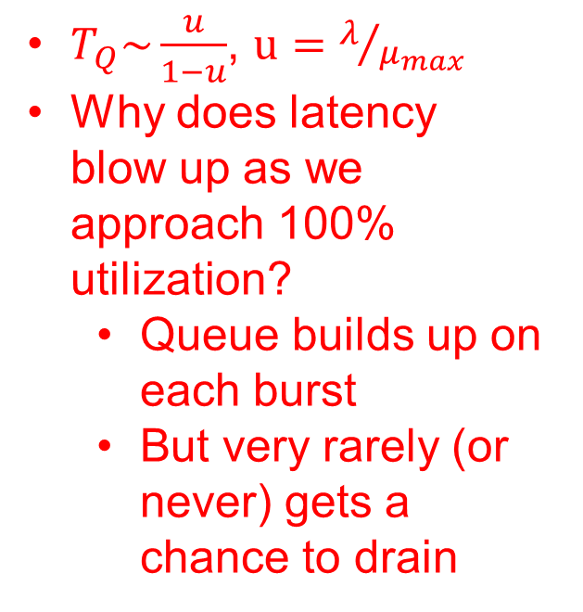
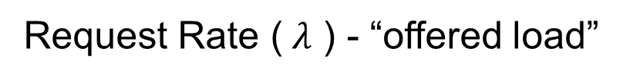
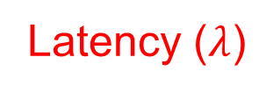


System Performance In presence of a Queue
$T_{Q}\sim \frac{u}{1−u}$, $u=λ/{μ_{max}}$
Why does latency blow up as we approach 100% utilization?
  Queue builds up on each burst
  But very rarely (or never) gets a chance to drain
Latency ($λ$)
Service Rate ($μ$) - “delivered load”
Time
$$μmax$$
Operation Time
$$μmax$$
Request Rate ($λ$ ) - “offered load”
“Half-Power Point” : load at which system delivers half of peak performance
Design and provision systems to operate roughly in this regime
Latency low and predictable, utilization good: ~50%

Slide 43
Why unbounded response time?
Assume deterministic arrival process and service time
  Possible to sustain utilization = 1 with bounded response time!
time
arrival
time
service
time

Slide 44
Why unbounded response time?
300
Response
Time (ms)
Assume stochastic arrival process
(and service time)
  No longer possible to achieve
  utilization = 1
200
100
This wasted time can never be reclaimed!
So cannot achieve u = 1!
0
0%
100%
Throughput (Utilization)
(% total BW)
time

Slide 45
A Little Queuing Theory: An Example
Example Usage Statistics:
  User requests 10 x 8KB disk I/Os per second
  Requests & service exponentially distributed (C=1.0)
  Avg. service = 20 ms (From controller+seek+rot+trans)
Questions:
  How utilized is the disk?
    Ans: server utilization, u = λT_{ser}
  What is the average time spent in the queue?
    Ans: T_{q}
  What is the number of requests in the queue?
    Ans: L_{q}
  What is the avg response time for disk request?
    Ans: T_{sys} = T_{q} + T_{ser}
Computation:
λ (avg # arriving customers/s) = 10/s
T_{ser} (avg time to service customer) = 20 ms (0.02s)
u (server utilization) = λ x T_{ser}= 10/s x .02s = 0.2
T_{q} (avg time/customer in queue) = T_{ser} x u/(1 – u)
= 20 x 0.2/(1-0.2) = 20 x 0.25 = 5 ms (0 .005s)
L_{q} (avg length of queue) = λ x T_{q}=10/s x .005s = 0.05
T_{sys} (avg time/customer in system) =T_{q} + T_{ser}= 25 ms

Slide 46
Queuing Theory Resources
Resources page contains Queueing Theory Resources (under Readings):
  Scanned pages from Patterson and Hennessy book that gives further discussion and simple proof for general equation: https://cs162.eecs.berkeley.edu/static/readings/patterson_queue.pdf
  A complete website full of resources: http://web2.uwindsor.ca/math/hlynka/qonline.html
Some previous midterms with queueing theory questions
Assume that Queueing Theory is fair game for Midterm III!

Slide 47
Optimize I/O Performance
Controller
300
Response
Time (ms)
User
Thread
I/O
device
200
Queue
[OS Paths]
100
Response Time =
Queue + I/O device service time
0
0%
100%
How to improve performance?
  Make everything faster ☺
  More Decoupled (Parallelism) systems
    multiple independent buses or controllers
  Optimize the bottleneck to increase service rate
    Use the queue to optimize the service
  Do other useful work while waiting
Queues absorb bursts and smooth the flow
Admissions control (finite queues)
  Limits delays, but may introduce unfairness and livelock
Throughput (Utilization)
(% total BW)

Slide 48

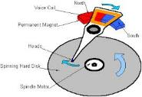




Recall: I/O and Storage Layers
Application / Service
High Level I/O
Streams
Low Level I/O
File Descriptors
What we covered in Lecture 4
Syscall
open(), read(), write(), close(), …
Open File Descriptions
File System
Files/Directories/Indexes
What we will cover next…
I/O Driver
Commands and Data Transfers
Disks, Flash, Controllers, DMA
What we just covered…

Slide 49
From Storage to File Systems
I/O API and
syscalls
Variable-Size Buffer
Memory Address
Logical Index,
Typically 4 KB
File System
Block
Flash Trans. Layer
Hardware Devices
Sector(s)
Sector(s)
Sector(s)
Phys. Block
Phys Index., 4KB
Physical Index,
512B or 4KB
Erasure Page
HDD
SSD

Slide 50
Building a File System
File System: Layer of OS that transforms block interface of disks (or other block devices) into Files, Directories, etc.
Classic OS situation: Take limited hardware interface (array of blocks) and provide a more convenient/useful interface with:
  Naming: Find file by name, not block numbers
  Organize file names with directories
  Organization: Map files to blocks
  Protection: Enforce access restrictions
  Reliability: Keep files intact despite crashes, hardware failures, etc.

Slide 51
Recall: User vs. System View of a File
User’s view:
  Durable Data Structures
System’s view (system call interface):
  Collection of Bytes (UNIX)
  Doesn’t matter to system what kind of data structures you want to store on disk!
System’s view (inside OS):
  Collection of blocks (a block is a logical transfer unit, while a sector is the physical transfer unit)
  Block size ≥ sector size; in UNIX, block size is 4KB

Slide 52

Translation from User to System View
File
(Bytes)
File
System
What happens if user says: “give me bytes 2 – 12?”
  Fetch block corresponding to those bytes
  Return just the correct portion of the block
What about writing bytes 2 – 12?
  Fetch block, modify relevant portion, write out block
Everything inside file system is in terms of whole-size blocks
  Actual disk I/O happens in blocks
  read/write smaller than block size needs to translate and buffer

Slide 53
Disk Management
Basic entities on a disk:
  File: user-visible group of blocks arranged sequentially in logical space
  Directory: user-visible index mapping names to files
The disk is accessed as linear array of sectors
How to identify a sector?
  Physical position
    Sectors is a vector [cylinder, surface, sector]
    Not used anymore
    OS/BIOS must deal with bad sectors
  Logical Block Addressing (LBA)
    Every sector has integer address
    Controller translates from address ⇒ physical position
    Shields OS from structure of disk

Slide 54
What Does the File System Need?
Track free disk blocks
  Need to know where to put newly written data
Track which blocks contain data for which files
  Need to know where to read a file from
Track files in a directory
  Find list of file's blocks given its name
Where do we maintain all of this?
  Somewhere on disk

Slide 55
Data Structures on Disk
Somewhat different from data structures in memory
Access a block at a time
  Can't efficiently read/write a single word
  Have to read/write full block containing it
  Ideally want sequential access patterns
Durability
  Ideally, file system is in meaningful state upon shutdown
  This obviously isn't always the case…

Slide 56
Critical Factors in File System Design
(Hard) Disks Performance !!!
  Maximize sequential access, minimize seeks
Open before Read/Write
  Can perform protection checks and look up where the actual file resource are, in advance
Size is determined as they are used !!!
  Can write (or read zeros) to expand the file
  Start small and grow, need to make room
Organized into directories
  What data structure (on disk) for that?
Need to carefully allocate / free blocks
  Such that access remains efficient

Slide 57
Components of a File System
File path
Directory
Structure
File
Header
Structure
One Block = multiple sectors
Ex: 512 sector, 4K block
File number
“inumber”
Data blocks
“inode”
…

Slide 58
Conclusion
Devices have complex interaction and performance characteristics
  Response time (Latency) = Queue + Overhead + Transfer
    Effective BW = BW * T/(S+T)
  HDD: Queuing time + controller + seek + rotation + transfer
  SSD: Queuing time + controller + transfer (erasure & wear)
Bursts & High Utilization introduce queuing delays
Queuing Latency:
  M/M/1 and M/G/1 queues: simplest to analyze
  As utilization approaches 100%, latency → ∞
  T_{q} = T_{ser} x ½(1+C) x u/(1 – u))
File System:
  Transforms blocks into Files and Directories
  Optimize for access and usage patterns
  Maximize sequential access, allow efficient random access

