Slide 1
CS162
Operating Systems and
Systems Programming
Lecture 25
Distributed 2: Distributed Decision Making (Con’t),
RPC, and Distributed Storage
April 25th, 2024
Prof. John Kubiatowicz
http://cs162.eecs.Berkeley.edu

Slide 2
Recall: Distributed Consensus Making
Consensus problem
  All nodes propose a value
  Some nodes might crash and stop responding
  Eventually, all remaining nodes decide on the same value from set of proposed values
Distributed Decision Making
  Choose between “true” and “false”
  Or Choose between “commit” and “abort”
Equally important (but often forgotten!): make it durable!
  How do we make sure that decisions cannot be forgotten?
    This is the “D” of “ACID” in a regular database
  In a global-scale system?
    What about erasure coding or massive replication?
    Like BlockChain applications!

Slide 3
Recall: Two-Phase Commit Protocol (2PC)
Prepare Phase:
  The global coordinator requests that all participants will promise to commit or rollback the transaction
  Participants record promise in log, then acknowledge
  If anyone votes to abort, coordinator writes "Abort" in its log and tells everyone to abort; each records "Abort" in log
Commit Phase:
  After all participants respond that they are prepared, then the coordinator writes "Commit" to its log
  Then asks all nodes to commit; they respond with ACK
  After receive ACKs, coordinator writes "Got Commit" to log
Persistent stable log on each machine: keep track of whether commit has happened
  Required for good semantics
  If a machine crashes, when it wakes up it first checks its log to recover state of world at time of crash

Slide 4
Alternatives to 2PC
Three-Phase Commit: One more phase, allows nodes to fail or block and still make progress.
PAXOS: An alternative used by Google and others that does not have 2PC blocking problem
  Develop by Leslie Lamport (Turing Award Winner)
  No fixed leader, can choose new leader on fly, deal with failure
  Some think this is extremely complex!
RAFT: PAXOS alternative from John Osterhout (Stanford)
  Simpler to describe complete protocol
What happens if one or more of the nodes is malicious?
  Malicious: attempting to compromise the decision making
  Use a more hardened decision making process:
  Byzantine Agreement and Block Chains

Slide 5
Byzantine General’s Problem
Lieutenant
Attack!
Attack!
Attack!
Attack!
Retreat!
Attack!
Attack!
Lieutenant
Retreat!
General
Attack!
Lieutenant
Malicious!
Byazantine General’s Problem (n players):
  One General and n-1 Lieutenants
  Some number of these (f) can be insane or malicious
The commanding general must send an order to his n-1 lieutenants such that the following Integrity Constraints apply:
  IC1: All loyal lieutenants obey the same order
  IC2: If the commanding general is loyal, then all loyal lieutenants obey the order he sends

Slide 6
Byzantine General’s Problem (con’t)
Impossibility Results:
  Cannot solve Byzantine General’s Problem with n=3 because one malicious player can mess up things
  With f faults, need n > 3f to solve problem
Various algorithms exist to solve problem
  Original algorithm has #messages exponential in n
  Newer algorithms have message complexity O(n²)
    One from MIT, for instance (Castro and Liskov, 1999)
Use of BFT (Byzantine Fault Tolerance) algorithm
  Allow multiple machines to make a coordinated decision even if some subset of them (< n/3 ) are malicious
General
General
Attack!
Attack!
Attack!
Retreat!
Lieutenant
Lieutenant
Lieutenant
Lieutenant
Retreat!
Retreat!
Request
Distributed
Decision

Slide 7
Is a BlockChain a Distributed Decision Making Algorithm?
Tentative Head #1
Root
Block
Tentative Head #2
Hash Ptr
The “Block Chain”
BlockChain: a chain of blocks connected by hashes to root block
  The Hash Pointers are unforgeable (assumption)
  The Chain has no branches except perhaps for heads
  Blocks are considered “authentic” part of chain when they have authenticity info in them
How is the head chosen?
  Some consensus algorithm
  In many BlockChain algorithms (e.g. BitCoin, Ethereum), the head is chosen by solving hard problem
    This is the job of “miners” who try to find “nonce” info that makes hash over block have specified number of zero bits in it
    The result is a “Proof of Work” (POW)
    Selected blocks above (green) have POW in them and can be included in chains
  Longest chain wins

Slide 8
Is a Blockchain a Distributed Decision Making Algorithm? (Con’t)
Miner:
Tries to solve POW problem
Observer:
Tracks state of
BlockChain
Miner:
Tries to solve POW problem
Observer:
Tracks state of
BlockChain
Proposal
Observer:
Tracks state of
BlockChain
Root
Block
Root
Block
Hash Ptr
Root
Block
Root
Block
Hash Ptr
Hash Ptr
Root
Block
Hash Ptr
Epidemic
Replication
Hash Ptr
Observer:
Tracks state of
BlockChain
Observer:
Tracks state of
BlockChain
Observer:
Tracks state of
BlockChain
Observer:
Tracks state of
BlockChain
Observer:
Tracks state of
BlockChain
Miner:
Tries to solve POW problem
Observer:
Tracks state of
BlockChain
Root
Block
Root
Block
Hash Ptr
Root
Block
Hash Ptr
Root
Block
Hash Ptr
Root
Block
Hash Ptr
Root
Block
Root
Block
Hash Ptr
Hash Ptr
Hash Ptr
Decision means: Proposal is locked into BlockChain
  Could be Commit/Abort decision
  Could be Choice of Value, State Transition, ….
NAK: Didn’t make it into the block chain (must retry!)
Anyone in world can verify the result of decision making!
Proposal

Slide 9
Recall: Distributed Applications Build With Messages
How do you actually program a distributed application?
  Need to synchronize multiple threads, running on different machines
    No shared memory, so cannot use test&set
  One Abstraction: send/receive messages
    Already atomic: no receiver gets portion of a message and two receivers cannot get same message
Interface:
  Mailbox (mbox): temporary holding area for messages
    Includes both destination location and queue
    Over Internet, destination specified by IP address and Port (Recall Web server example!)
  Send(message,mbox)
    Send message to remote mailbox identified by mbox
  Receive(buffer,mbox)
    Wait until mbox has message, copy into buffer, and return
    If threads sleeping on this mbox, wake up one of them
Send
Network
Receive

Slide 10
How do we know that both sides speak same language?
An object in memory has a machine-specific binary representation
  Threads within a single process have the same view of what’s in memory
  Easy to compute offsets into fields, follow pointers, etc.
In the absence of shared memory, externalizing an object requires us to turn it into a sequential sequence of bytes
  Serialization/Marshalling: Express an object as a sequence of bytes
  Deserialization/Unmarshalling: Reconstructing the original object from its marshalled form at destination

Slide 11
Simple Data Types
uint32_t x;
Suppose I want to write a x to a file
First, open the file: FILE* f = fopen(“foo.txt”, “w”);
Then, I have two choices:
  fprintf(f, “%lu”, x);
  fwrite(&x, sizeof(uint32_t), 1, f);
    Or equivalently, write(fd, &x, sizeof(uint32_t)); (perhaps with a loop to be safe)
Neither one is “wrong” but sender and receiver should be consistent!

Slide 12
Machine Representation
Consider using the machine representation:
  fwrite(&x, sizeof(uint32_t), 1, f);
How do we know if the recipient represents x in the same way?
  For pipes, is this a problem?
  What about for sockets?

Slide 13
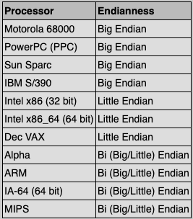
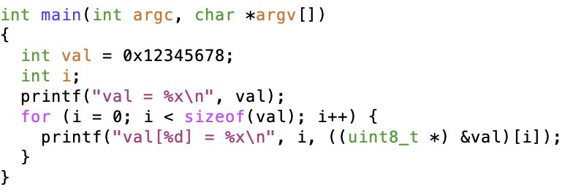
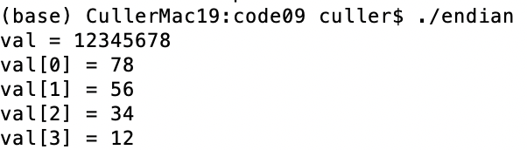
Endianness
For a byte-address machine, which end of a machine-recognized object (e.g., int) does its byte-address refer to?
Big Endian: address points to most-significant byte
Little Endian: address points to least-significant byte
Experiment:
Result:

Slide 14
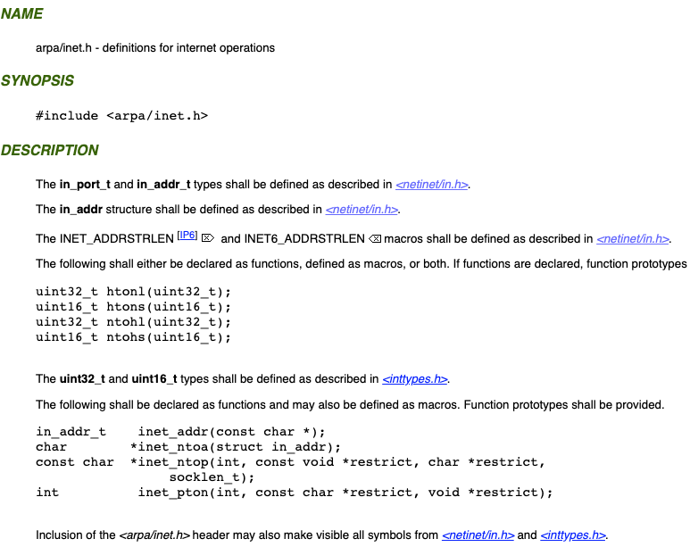
What Endian is the Internet?
Big Endian
  Network byte order
  Vs. “host byte order”

Slide 15
Dealing with Endianness
Decide on an “on-wire” endianness
Convert from native endianness to “on-wire” endianness before sending out data (serialization/marshalling)
  uint32_t htonl(uint32_t) and uint16_t htons(uint16_t) convert from native endianness to network endianness (big endian)
Convert from “on-wire” endianness to native endianness when receiving data (deserialization/unmarshalling)
  uint32_t ntohl(uint32_t) and uint16_t ntohs(uint16_t) convert from network endianness to native endianness (big endian)

Slide 16
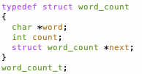
What About Richer Objects?
Consider word_count_t of Homework 0 and 1 …
Each element contains:
  An int
  A pointer to a string (of some length)
  A pointer to the next element
fprintf_words writes these as a sequence of lines (character strings with \n) to a file stream
What if you wanted to write the whole list as a binary object (and read it back as one)?
  How do you represent the string?
  Does it make any sense to write the pointer?

Slide 17
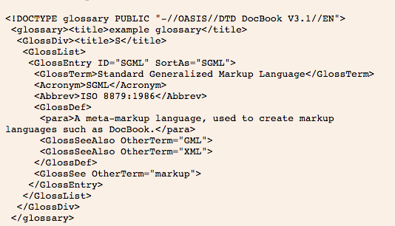
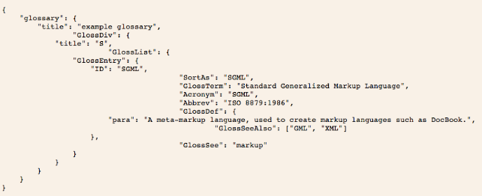
Data Serialization Formats
JSON and XML are commonly used in web applications
Lots of ad-hoc formats

Slide 18
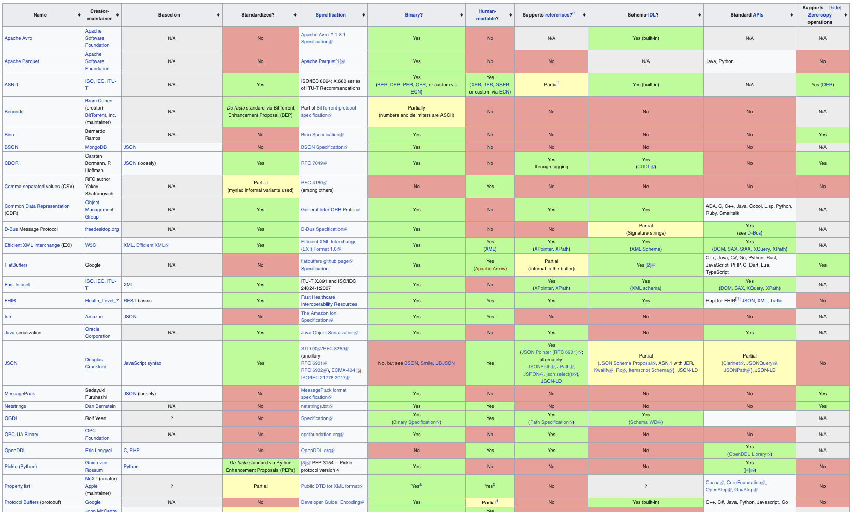
Data Serialization Formats: Many Options

Slide 19
Administrivia
Midterm 3: This Thursday!
  No class on Thursday. I’ll have special office hours during class time.
  Three double-sided pages of notes
  Watch for Ed post about where you should go: we have multiple exam rooms
All material up to today’s lecture is fair game
Final deadlines during RRR week:
  Yes, there will be office hours – watch for specifics
Also – we have a special lecture (just for fun) next Tuesday
  During normal class time!

Slide 20
Administrivia (Con’t)
You need to know your units as CS/Engineering students!
Units of Time: “s”: Second, “min”: 60s, “h”: 3600s, (of course)
  Millisecond: 1ms ⇒ 10⁻³ s
  Microsecond: 1μs ⇒ 10⁻⁶ s
  Nanosecond: 1ns: ⇒ 10⁻⁹ s
  Picosecond: 1ps ⇒ 10⁻¹² s
Integer Sizes: “b” ⇒ ”bit”, “B” ⇒ “byte” == 8 bits, “W”⇒”word”==? (depends. Could be 16b, 32b, 64b)
Units of Space (memory), sometimes called the “binary system”
  Kilo: 1KB ≡ 1KiB ⇒ 1024 bytes == 2¹⁰ bytes == 1024 ≈ 1.0×10³
  Mega: 1MB ≡ 1MiB ⇒ (1024)² bytes == 2²⁰ bytes == 1,048,576 ≈ 1.0×10⁶
  Giga: 1GB ≡ 1GiB ⇒ (1024)³ bytes == 2³⁰ bytes == 1,073,741,824 ≈ 1.1×10⁹
  Tera: 1TB ≡ 1TiB ⇒ (1024)⁴ bytes == 2⁴⁰ bytes == 1,099,511,627,776 ≈ 1.1×10¹²
  Peta: 1PB ≡ 1PiB ⇒ (1024)⁵ bytes == 2⁵⁰ bytes == 1,125,899,906,842,624 ≈ 1.1 × 10¹⁵
  Exa: 1EB ≡ 1EiB ⇒ (1024)⁶ bytes == 2⁶⁰ bytes == 1,152,921,504,606,846,976 ≈ 1.2 × 10¹⁸
Units of Bandwidth, Space on disk/etc, Everything else…, sometimes called the “decimal system”
  Kilo: 1KB/s ⇒ 10³ bytes/s, 1KB ⇒ 10³ bytes
  Mega: 1MB/s ⇒ 10⁶ bytes/s, 1MB ⇒ 10⁶ bytes
  Giga: 1GB/s ⇒ 10⁹ bytes/s, 1GB ⇒ 10⁹ bytes
  Tera: 1TB/s ⇒ 10¹² bytes/s, 1TB ⇒ 10¹² bytes
  Peta: 1PB/s ⇒ 10¹⁵ bytes/s, 1PB ⇒ 10¹⁵ bytes
  Exa: 1EB/s ⇒ 10¹⁸ bytes/s, 1EB ⇒ 10¹⁸ bytes

Slide 21
Remote Procedure Call (RPC)
Raw messaging is a bit too low-level for programming
  Must wrap up information into message at source
  Must decide what to do with message at destination
  May need to sit and wait for multiple messages to arrive
  And must deal with machine representation by hand
Another option: Remote Procedure Call (RPC)
  Calls a procedure on a remote machine
  Idea: Make communication look like an ordinary function call
  Automate all of the complexity of translating between representations
  Client calls:
  remoteFileSystem→Read("rutabaga");
  Translated automatically into call on server:
  fileSys→Read("rutabaga");

Slide 22
RPC Concept
bundle
args
Client (caller)
r = f(v1, v2);
call
Client
Stub
send
return
receive
unbundle
ret vals
bundle
ret vals
Server (callee)
res_t f(a1, a2)
return
Server
Stub
send
call
receive
unbundle
args

Slide 23
RPC Information Flow
bundle
args
Client (caller)
r = f(v1, v2);
call
Client
Stub
send
Packet
Handler
return
receive
unbundle
ret vals
Machine A
Network
Network
Machine B
bundle
ret vals
Server (callee)
res_t f(a1, a2)
return
Server
Stub
send
Packet
Handler
Server
Stub
call
receive
unbundle
args
unbundle
args

Slide 24
RPC Implementation
Request-response message passing (under covers!)
“Stub” provides glue on client/server
  Client stub is responsible for “marshalling” arguments and “unmarshalling” the return values
  Server-side stub is responsible for “unmarshalling” arguments and “marshalling” the return values.
Marshalling involves (depending on system)
  Converting values to a canonical form, serializing objects, copying arguments passed by reference, etc.
  Use of standardized serialization protocol

Slide 25
RPC Details (1/3)
Equivalence with regular procedure call
  Parameters ⇔ Request Message
  Result ⇔ Reply message
  Name of Procedure: Passed in request message
  Return Address: mbox2 (client return mail box)
Stub generator: Compiler that generates stubs
  Input: interface definitions in an “interface definition language (IDL)”
    Contains, among other things, types of arguments/return
  Output: stub code in the appropriate source language
    Code for client to pack message, send it off, wait for result, unpack result and return to caller
    Code for server to unpack message, call procedure, pack results, send them off
Notes:
…
- You might imagine that this stub code, to marshal arguments and make requests over the network, looks similar for many different remote function calls. We can actually generate it automatically, with a compiler!

Slide 26
RPC Details (2/3)
Cross-platform issues:
  What if client/server machines are different architectures/ languages?
    Convert everything to/from some canonical form
    Tag every item with an indication of how it is encoded (avoids unnecessary conversions)
How does client know which mbox (destination queue) to send to?
  Need to translate name of remote service into network endpoint (Remote machine, port, possibly other info)
  Binding: the process of converting a user-visible name into a network endpoint
    This is another word for “naming” at network level
    Static: fixed at compile time
    Dynamic: performed at runtime

Slide 27
RPC Details (3/3)
Dynamic Binding
  Most RPC systems use dynamic binding via name service
    Name service provides dynamic translation of service → mbox
  Why dynamic binding?
    Access control: check who is permitted to access service
    Fail-over: If server fails, use a different one
What if there are multiple servers?
  Could give flexibility at binding time
    Choose unloaded server for each new client
  Could provide same mbox (router level redirect)
    Choose unloaded server for each new request
    Only works if no state carried from one call to next
What if multiple clients?
  Pass pointer to client-specific return mbox in request

Slide 28
Problems with RPC: Non-Atomic Failures
Different failure modes in dist. system than on a single machine
Consider many different types of failures
  User-level bug causes address space to crash
  Machine failure, kernel bug causes all processes on same machine to fail
  Some machine is compromised by malicious party
Before RPC: whole system would crash/die
After RPC: One machine crashes/compromised while others keep working
Can easily result in inconsistent view of the world
  Did my cached data get written back or not?
  Did server do what I requested or not?
Answer? Distributed transactions/Byzantine Commit

Slide 29
Problems with RPC: Performance
RPC is not performance transparent:
  Cost of Procedure call « same-machine RPC « network RPC
  Overheads: Marshalling, Stubs, Kernel-Crossing, Communication
Programmers must be aware that RPC is not free
  Caching can help, but may make failure handling complex

Slide 30
Cross-Domain Communication/Location Transparency
How do address spaces communicate with one another?
  Shared Memory with Semaphores, monitors, etc…
  File System
  Pipes (1-way communication)
  “Remote” procedure call (2-way communication)
RPC’s can be used to communicate between address spaces on different machines or the same machine
  Services can be run wherever it’s most appropriate
  Access to local and remote services looks the same
Examples of RPC systems:
  CORBA (Common Object Request Broker Architecture)
  DCOM (Distributed COM)
  RMI (Java Remote Method Invocation)

Slide 31
Microkernel operating systems
Example: split kernel into application-level servers.
  File system looks remote, even though on same machine
Why split the OS into separate domains?
  Fault isolation: bugs are more isolated (build a firewall)
  Enforces modularity: allows incremental upgrades of pieces of software (client or server)
  Location transparent: service can be local or remote
    For example in the X windowing system: Each X client can be on a separate machine from X server; Neither has to run on the machine with the frame buffer.
App
App
App
App
File
sys
windows
file system
Windowing
address
spaces
RPC
VM
Networking
Threads
threads
Monolithic Structure
Microkernel Structure

Slide 32


Network-Attached Storage and the CAP Theorem
Network
Consistency:
  Changes appear to everyone in the same serial order
Availability:
  Can get a result at any time
Partition-Tolerance
  System continues to work even when network becomes partitioned
Consistency, Availability, Partition-Tolerance (CAP) Theorem: Cannot have all three at same time
  Otherwise known as “Brewer’s Theorem”

Slide 33

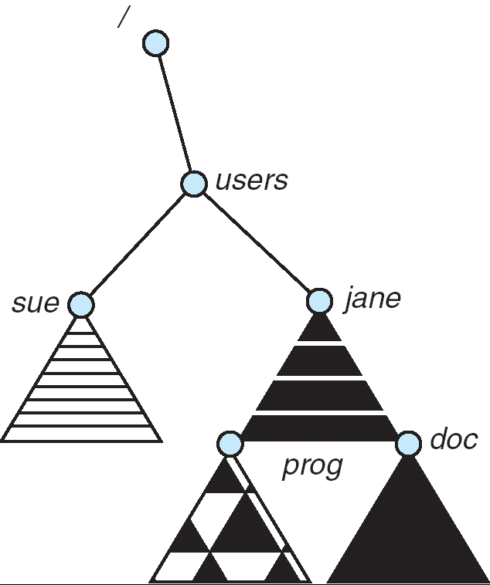
Distributed File Systems
Read File
Network
Data
Client
Server
mount
adj:/jane
Transparent access to files stored on a remote disk
Mount remote files into your local file system
  Directory in local file system refers to remote files
  e.g., /users/jane/prog/foo.c on laptop actually refers to
  /prog/foo.c on adj.cs.berkeley.edu
Naming Choices:
  [Hostname,localname]: Filename includes server
    No location or migration transparency, except
    through DNS remapping
  A global name space: Filename unique in “world”
    Can be served by any server
mount
coeus:/sue
mount
adj:/prog

Slide 34


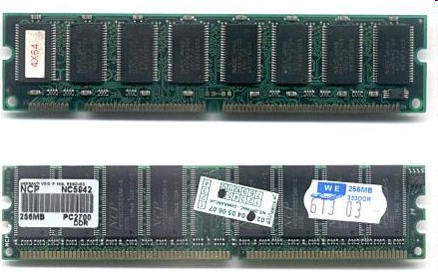
Enabling Design: VFS
The System Call Interface
Process
Management
Memory
Management
Filesystems
Device
Control
Networking
Concurrency,
multitasking
Virtual
memory
Files and dirs:
the VFS
TTYs and
device access
Connectivity
Architecture
Dependent
Code
Memory
Manager
File System Types
Device
Control
Network
Subsystem
Block
Devices
IF drivers

Slide 35
Recall: Layers of I/O…
User App:
length = read(input_fd, buffer, BUFFER_SIZE);
User library:
ssize_t read(int, void *, size_t) {
marshal args into registers
issue syscall
register result of syscall to rtn value
};
Application / Service
High Level I/O
Low Level I/O
Exception U→K, interrupt processing
Syscall
void syscall_handler (struct intr_frame *f) {
unmarshall call#, args from regs
dispatch : handlers[call#](args)
marshal results fo syscall ret
}
File System
I/O Driver
ssize_t vfs_read(struct file *file, char __user *buf, size_t count, loff_t *pos) {
User Process/File System relationship
call device driver to do the work
}
Device Driver

Slide 36
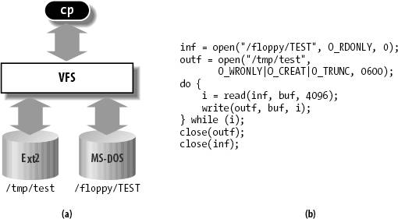
Virtual Filesystem Switch
VFS: Virtual abstraction similar to local file system
  Provides virtual superblocks, inodes, files, etc
  Compatible with a variety of local and remote file systems
    provides object-oriented way of implementing file systems
VFS allows the same system call interface (the API) to be used for different types of file systems
  The API is to the VFS interface, rather than any specific type of file system

Slide 37
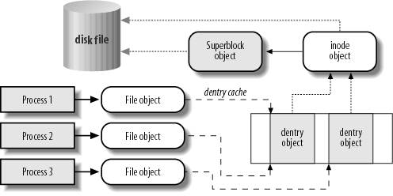
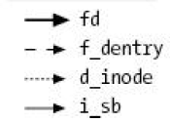
VFS Common File Model in Linux
Four primary object types for VFS:
  superblock object: represents a specific mounted filesystem
  inode object: represents a specific file
  dentry object: represents a directory entry
  file object: represents open file associated with process
There is no specific directory object (VFS treats directories as files)
May need to fit the model by faking it
  Example: make it look like directories are files
  Example: make it look like have inodes, superblocks, etc.

Slide 38
Simple Distributed File System
Read (RPC)
Return (Data)
Client
Write (RPC)
Server
cache
ACK
Client
Remote Disk: Reads and writes forwarded to server
  Use Remote Procedure Calls (RPC) to translate file system calls into remote requests
  No local caching, but can be cache at server-side
Advantage: Server provides consistent view of file system to multiple clients
Problems? Performance!
  Going over network is slower than going to local memory
  Lots of network traffic/not well pipelined
  Server can be a bottleneck

Slide 39
Use of caching to reduce network load
Crash!
Crash!
read(f1)
→V1
cache
Read (RPC)
read(f1)→V1
read(f1)→V1
F1:V1
Return (Data)
read(f1)→V1
Client
cache
Write (RPC)
Server
F1:V1
F1:V2
ACK
cache
write(f1)
→OK
F1:V2
read(f1)→V2
Client
Idea: Use caching to reduce network load
  In practice: use buffer cache at source and destination
Advantage: if open/read/write/close can be done locally, don’t need to do any network traffic…fast!
Problems:
  Failure:
    Client caches have data not committed at server
  Cache consistency!
    Client caches not consistent with server/each other

Slide 40
Dealing with Failures
What if server crashes? Can client wait until it comes back and just continue making requests?
  Changes in server's cache but not in disk are lost
What if there is shared state across RPC's?
  Client opens file, then does a seek
  Server crashes
  What if client wants to do another read?
Similar problem: What if client removes a file but server crashes before acknowledgement?

Slide 41
Stateless Protocol
Stateless Protocol: A protocol in which all information required to service a request is included with the request
Even better: Idempotent Operations – repeating an operation multiple times is same as executing it just once (e.g., storing to a mem addr.)
Client: timeout expires without reply, just run the operation again (safe regardless of first attempt)
Recall HTTP: Also a stateless protocol
  Include cookies with request to simulate a session

Slide 42
Case Study: Network File System (NFS)
Three Layers for NFS system
  UNIX file-system interface: open, read, write, close calls + file descriptors
  VFS layer: distinguishes local from remote files
    Calls the NFS protocol procedures for remote requests
  NFS service layer: bottom layer of the architecture
    Implements the NFS protocol
NFS Protocol: RPC for file operations on server
  XDR Serialization standard for data format independence
  Reading/searching a directory
  manipulating links and directories
  accessing file attributes/reading and writing files
Write-through caching: Modified data committed to server’s disk before results are returned to the client
  lose some of the advantages of caching
  time to perform write() can be long
  Need some mechanism for readers to eventually notice changes! (more on this later)

Slide 43
NFS Continued
NFS servers are stateless; each request provides all arguments require for execution
  E.g. reads include information for entire operation, such as ReadAt(inumber,position), not Read(openfile)
  No need to perform network open() or close() on file – each operation stands on its own
Idempotent: Performing requests multiple times has same effect as performing them exactly once
  Example: Server crashes between disk I/O and message send, client resend read, server does operation again
  Example: Read and write file blocks: just re-read or re-write file block – no other side effects
  Example: What about “remove”? NFS does operation twice and second time returns an advisory error
Failure Model: Transparent to client system
  Is this a good idea? What if you are in the middle of reading a file and server crashes?
  Options (NFS Provides both):
    Hang until server comes back up (next week?)
    Return an error. (Of course, most applications don’t know they are talking over network)

Slide 44
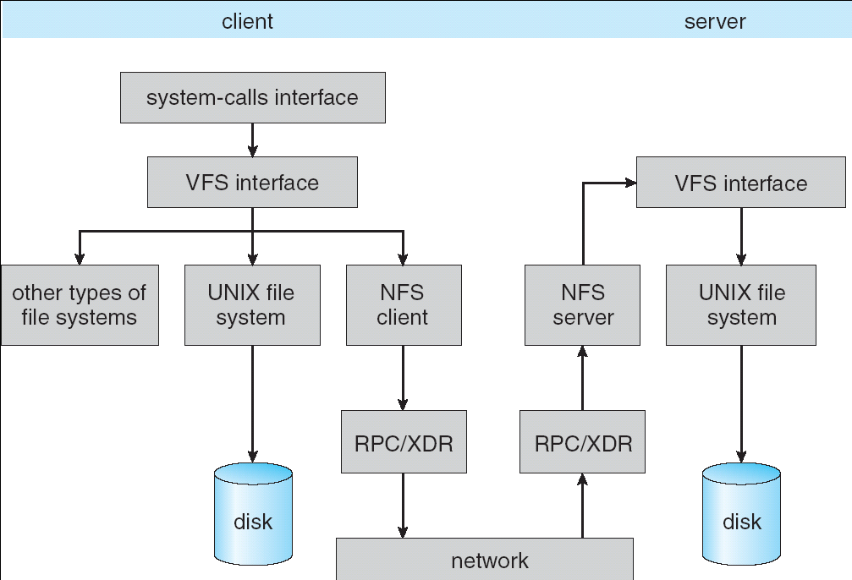
NFS Architecture

Slide 45
NFS Cache consistency
NFS protocol: weak consistency
  Client polls server periodically to check for changes
    Polls server if data hasn’t been checked in last 3-30 seconds (exact timeout is tunable parameter).
    Thus, when file is changed on one client, server is notified, but other clients use old version of file until timeout.
  What if multiple clients write to same file?
    In NFS, can get either version (or parts of both)
    Completely arbitrary!
cache
F1 still ok?
F1:V2
F1:V1
No: (F1:V2)
Client
cache
Write (RPC)
Server
F1:V2
ACK
cache
F1:V2
Client

Slide 46
Sequential Ordering Constraints
What sort of cache coherence might we expect?
  i.e. what if one CPU changes file, and before it’s done, another CPU reads file?
Example: Start with file contents = “A”
What would we actually want?
  Assume we want distributed system to behave exactly the same as if all processes are running on single system
    If read finishes before write starts, get old copy
    If read starts after write finishes, get new copy
    Otherwise, get either new or old copy
  For NFS:
    If read starts more than 30 seconds after write, get new copy; otherwise, could get partial update
Client 1:
Read: gets A
Write B
Read: parts of B or C
Client 2:
Read: gets A or B
Write C
Client 3:
Read: parts of B or C
Time

Slide 47
NFS Pros and Cons
NFS Pros:
  Simple, Highly portable
NFS Cons:
  Sometimes inconsistent!
  Doesn’t scale to large # clients
    Must keep checking to see if caches out of date
    Server becomes bottleneck due to polling traffic

Slide 48
Andrew File System
Andrew File System (AFS, late 80’s) → DCE DFS (commercial product)
Callbacks: Server records who has copy of file
  On changes, server immediately tells all with old copy
  No polling bandwidth (continuous checking) needed
Write through on close
  Changes not propagated to server until close()
  Session semantics: updates visible to other clients only after the file is closed
    As a result, do not get partial writes: all or nothing!
    Although, for processes on local machine, updates visible immediately to other programs who have file open
In AFS, everyone who has file open sees old version
  Don’t get newer versions until reopen file

Slide 49
Andrew File System (con’t)
Data cached on local disk of client as well as memory
  On open with a cache miss (file not on local disk):
    Get file from server, set up callback with server
  On write followed by close:
    Send copy to server; tells all clients with copies to fetch new version from server on next open (using callbacks)
What if server crashes? Lose all callback state!
  Reconstruct callback information from client: go ask everyone “who has which files cached?”
AFS Pro: Relative to NFS, less server load:
  Disk as cache ⇒ more files can be cached locally
  Callbacks ⇒ server not involved if file is read-only
For both AFS and NFS: central server is bottleneck!
  Performance: all writes→server, cache misses→server
  Availability: Server is single point of failure
  Cost: server machine’s high cost relative to workstation

Slide 50
Summary (1/2)
Byzantine General’s Problem: distributed decision making with malicious failures
  One general, n-1 lieutenants: some number of them may be malicious (often “f” of them)
  All non-malicious lieutenants must come to same decision
  If general not malicious, lieutenants must follow general
  Only solvable if n ≥ 3f+1
BlockChain protocols:
  Cryptographically-driven ordering protocol
  Could be used for distributed decision making
Remote Procedure Call (RPC): Call procedure on remote machine or in remote domain
  Provides same interface as procedure
  Automatic packing and unpacking of arguments without user programming (in stub)
  Adapts automatically to different hardware and software architectures at remote end

Slide 51
Summary (2/2)
Distributed File System:
  Transparent access to files stored on a remote disk
  Caching for performance
VFS: Virtual File System layer (Or Virtual Filesystem Switch)
  Provides mechanism which gives same system call interface for different types of file systems
Cache Consistency: Keeping client caches consistent with one another
  If multiple clients, some reading and some writing, how do stale cached copies get updated?
  NFS: check periodically for changes
  AFS: clients register callbacks to be notified by server of changes

