Slide 1
CS162
Operating Systems and
Systems Programming
Lecture 12
Scheduling 2:
Classic Policies (Con’t), Case Studies,
Realtime, Starvation
February 27th, 2024
Prof. John Kubiatowicz
http://cs162.eecs.Berkeley.edu

Slide 2
Recall: SRTF Example continued:
Disk Utilization:
9/201 ~ 4.5%
C
A
B
C
RR 100ms time slice
Disk Utilization:
~90% but lots of wakeups!
C’s
I/O
C’s
I/O
CABAB…
C
RR 1ms time slice
C’s
I/O
C’s
I/O
Disk Utilization:
90%
C
A
A
A
SRTF
C’s
I/O
C’s
I/O

Slide 3
SRTF Further discussion
Starvation
  SRTF can lead to starvation if many small jobs!
  Large jobs never get to run
Somehow need to predict future
  How can we do this?
  Some systems ask the user
    When you submit a job, have to say how long it will take
    To stop cheating, system kills job if takes too long
  But: hard to predict job’s runtime even for non-malicious users
Bottom line, can’t really know how long job will take
  However, can use SRTF as a yardstick for measuring other policies
  Optimal, so can’t do any better
SRTF Pros & Cons
  Optimal (average response time) (+)
  Hard to predict future (-)
  Unfair (-)

Slide 4
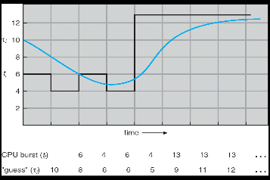
Predicting the Length of the Next CPU Burst
Adaptive: Changing policy based on past behavior
  CPU scheduling, in virtual memory, in file systems, etc
  Works because programs have predictable behavior
    If program was I/O bound in past, likely in future
    If computer behavior were random, wouldn’t help
Example: SRTF with estimated burst length
  Use an estimator function on previous bursts: Let t_{n-1}, t_{n-2}, t_{n-3}, etc. be previous CPU burst lengths. Estimate next burst τ_{n} = f(t_{n-1}, t_{n-2}, t_{n-3}, …)
  Function f could be one of many different time series estimation schemes
  (Kalman filters, etc)
  For instance: exponential averaging
  τ_{n} = αt_{n-1}+(1-α)τ_{n-1}
  with (0<α≤1)

Slide 5
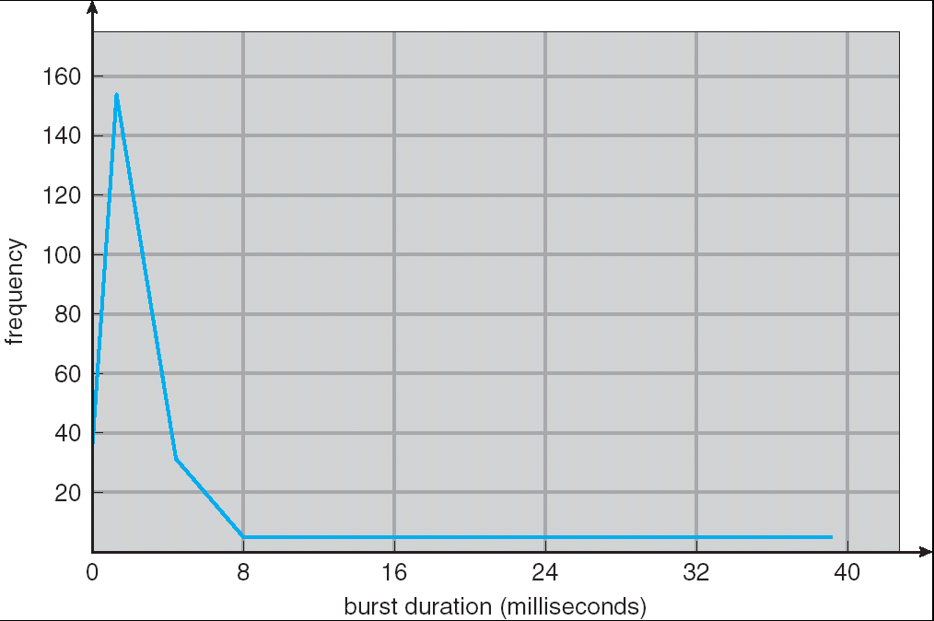
How to Handle Simultaneous Mix of Diff Types of Apps?
Consider mix of interactive and high throughput apps:
  How to best schedule them?
  How to recognize one from the other?
    Do you trust app to say that it is “interactive”?
  Should you schedule the set of apps identically on
  servers, workstations, pads, and cellphones?
For instance, is Burst Time (observed) useful to
decide which application gets CPU time?
  Short Bursts ⇒ Interactivity ⇒ High Priority?
Assumptions encoded into many schedulers:
  Apps that sleep a lot and have short bursts must
  be interactive apps – they should get high priority
  Apps that compute a lot should get low(er?) priority, since they won’t notice intermittent bursts from interactive apps
Hard to characterize apps:
  What about apps that sleep for a long time, but then compute for a long time?
  Or, what about apps that must run under all circumstances (say periodically)
Weighted toward small bursts

Slide 6
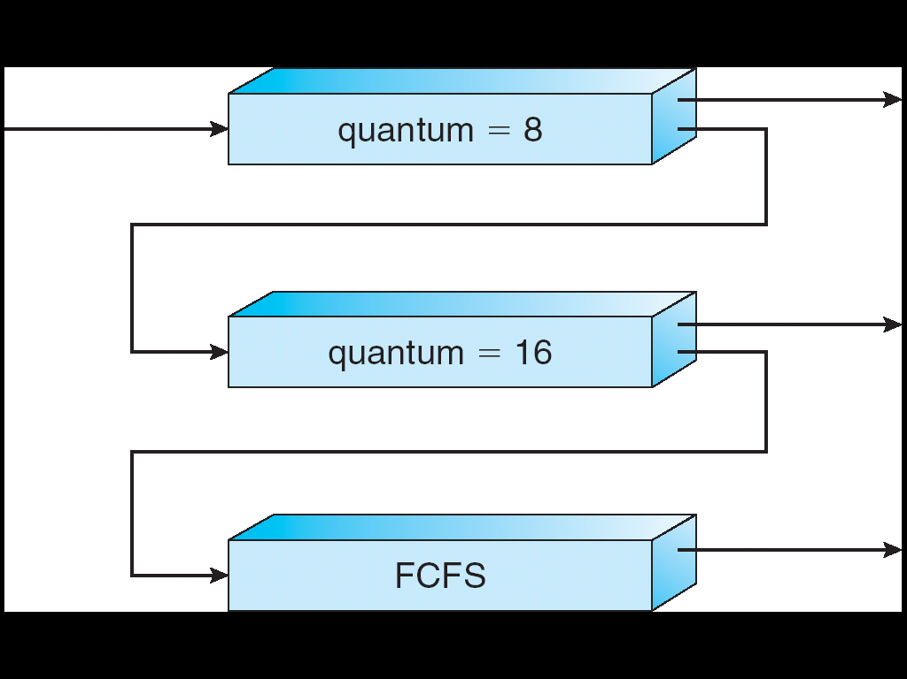
Multi-Level Feedback Scheduling
Another method for exploiting past behavior (first use in CTSS)
  Multiple queues, each with different priority
    Higher priority queues often considered “foreground” tasks
  Each queue has its own scheduling algorithm
    e.g. foreground – RR, background – FCFS
    Sometimes multiple RR priorities with quantum increasing exponentially
    (highest:1ms, next: 2ms, next: 4ms, etc)
Adjust each job’s priority as follows (details vary)
  Job starts in highest priority queue
  If timeout expires, drop one level
  If timeout doesn’t expire, push up one level (or to top)
Long-Running Compute
Tasks Demoted to
Low Priority

Slide 7
Scheduling Details
Long-Running Compute
Tasks Demoted to
Low Priority
Result approximates SRTF:
  CPU bound jobs drop like a rock
  Short-running I/O bound jobs stay near top
Scheduling must be done between the queues
  Fixed priority scheduling:
    serve all from highest priority, then next priority, etc.
  Time slice:
    each queue gets a certain amount of CPU time
    e.g., 70% to highest, 20% next, 10% lowest

Slide 8
Scheduling Details
Long-Running Compute
Tasks Demoted to
Low Priority
Countermeasure: user action that can foil intent of the OS designers
  For multilevel feedback, put in a bunch of meaningless I/O to keep job’s priority high
  Of course, if everyone did this, wouldn’t work!
Example of Othello program:
  Playing against competitor, so key was to do computing at higher priority the competitors.
    Put in printf’s, ran much faster!

Slide 9
Case Study: Linux O(1) Scheduler
Kernel/Realtime Tasks
User Tasks
0
100
139
Priority-based scheduler: 140 priorities
  40 for “user tasks” (set by “nice”), 100 for “Realtime/Kernel”
  Lower priority value ⇒ higher priority (for realtime values)
  Highest priority value ⇒ Lower priority (for nice values)
  All algorithms O(1)
    Timeslices/priorities/interactivity credits all computed when job finishes time slice
    140-bit bit mask indicates presence or absence of job at given priority level
Two separate priority queues: “active” and “expired”
  All tasks in the active queue use up their timeslices and get placed on the expired queue, after which queues swapped
Timeslice depends on priority – linearly mapped onto timeslice range
  Like a multi-level queue (one queue per priority) with different timeslice at each level
  Execution split into “Timeslice Granularity” chunks – round robin through priority

Slide 10
Linux O(1) Scheduler
Lots of ad-hoc heuristics
  Try to boost priority of I/O-bound tasks
  Try to boost priority of starved tasks

Slide 11
O(1) Scheduler Continued
Heuristics
  User-task priority adjusted ±5 based on heuristics
    p->sleep_avg = sleep_time – run_time
    Higher sleep_avg ⇒ more I/O bound the task, more reward (and vice versa)
  Interactive Credit
    Earned when a task sleeps for a “long” time
    Spend when a task runs for a “long” time
    IC is used to provide hysteresis to avoid changing interactivity for temporary changes in behavior
  However, “interactive tasks” get special dispensation
    To try to maintain interactivity
    Placed back into active queue, unless some other task has been starved for too long…
Real-Time Tasks
  Always preempt non-RT tasks
  No dynamic adjustment of priorities
  Scheduling schemes:
    SCHED_FIFO: preempts other tasks, no timeslice limit
    SCHED_RR: preempts normal tasks, RR scheduling amongst tasks of same priority

Slide 12
So, Does the OS Schedule Processes or Threads?
Many textbooks use the “old model”—one thread per process
Usually it's really: threads (e.g., in Linux) but can be task groups (also Linux)
Note: switching threads vs. switching processes incurs different costs:
  Switch threads: Save/restore registers
  Switch processes: Change active address space too!
    Expensive
    Disrupts caching
Recall, However: Simultaneous Multithreading (or “Hyperthreading”)
  Different threads interleaved on a cycle-by-cycle basis and can be in different processes (have different address spaces)

Slide 13
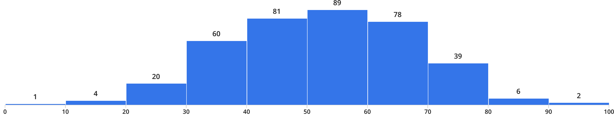
Administrivia
0 10 20 30 40 50 60 70 80 90 100
Midterm 1 results: Mean: 52.4, StdDev: 15.0, Min: 9.6, Max: 93.2!
Project 1 due tomorrow (Wednesday, 2/28)
  Code and final report
Also due Tomorrow: Peer evaluations
  These are a required mechanism for evaluating group dynamics
  Project scores are a zero-sum game
    In the normal/best case, all partners get the same grade
    In groups with issues, we may take points from non-participating group members and give them to participating group members!
Homework 3:
  Due Tuesday 3/5
  Can be done in Rust (if you want!)

Slide 14
Multi-Core Scheduling
Algorithmically, not a huge difference from single-core scheduling
Implementation-wise, helpful to have per-core scheduling data structures
  Cache coherence
Affinity scheduling: once a thread is scheduled on a CPU, OS tries to reschedule it on the same CPU
  Cache reuse, branch prediction
  Example for O(1) scheduler: 1 set of queues/core with background rebalancing

Slide 15
Recall: Spinlocks for multiprocessing
Spinlock implementation:
int value = 0; // Free
Acquire() {
while (test&set(&value)) {}; // spin while busy
}
Release() {
value = 0; // atomic store
}
Spinlock doesn’t put the calling thread to sleep—it just busy waits
  When might this be preferable?
    Waiting for limited number of threads at a barrier in a multiprocessing (multicore) program
    Wait time at barrier would be greatly increased if threads must be woken inside kernel
Every test&set() is a write, which makes value ping-pong around between core-local caches (using lots of memory!)
  So – really want to use test&test&set() !
As we discussed in Lecture 8, the extra read eliminates the ping-ponging issues:
  // Implementation of test&test&set():
  Acquire() {
  do {
  while(value); // wait until might be free
  } while (test&set(&value)); // exit if acquire lock
  }

Slide 16
Gang Scheduling and Parallel Applications
When multiple threads work together on a multi-core
system, try to schedule them together
  Makes spin-waiting more efficient (inefficient to spin-wait
  for a thread that’s suspended)
  Multiple phases of parallel and serial execution
Additionally: OS informs a parallel program how many processors its threads are scheduled on (Scheduler Activations)
  Application adapts to number of cores that it has scheduled
  “Space sharing” with other parallel programs can be more efficient, because parallel speedup is often sublinear with the number of cores
Barrier

Slide 17
Real-Time Scheduling
Goal: Predictability of Performance!
  We need to predict with confidence worst case response times for systems!
  In RTS, performance guarantees are:
    Task- and/or class centric and often ensured a priori
  In conventional systems, performance is:
    System/throughput oriented with post-processing (… wait and see …)
  Real-time is about enforcing predictability, and does not equal fast computing!!!
Hard real-time: for time-critical safety-oriented systems
  Meet all deadlines (if at all possible)
  Ideally: determine in advance if this is possible
  Earliest Deadline First (EDF), Least Laxity First (LLF),
  Rate-Monitonic Scheduling (RMS), Deadline Monotonic Scheduling (DM)
Soft real-time: for multimedia
  Attempt to meet deadlines with high probability
  Constant Bandwidth Server (CBS)

Slide 18
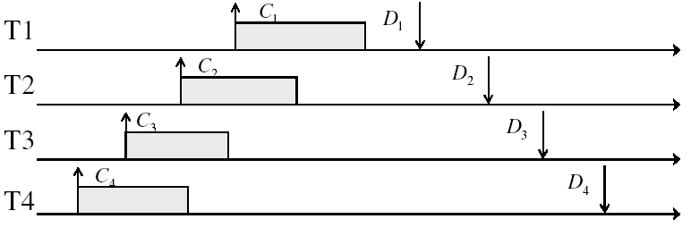
Example: Workload Characteristics
Tasks are preemptable, independent with arbitrary arrival (=release) times
Tasks have deadlines (D) and known computation times (C)
Example Setup:

Slide 19
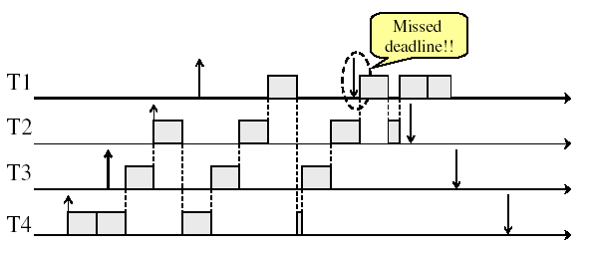
Example: Round-Robin Scheduling Doesn’t Work
Time

Slide 20

Earliest Deadline First (EDF)
Tasks periodic with period P and computation C in each period: ($P_{i}$, $C_{i}$) for each task $i$
Preemptive priority-based dynamic scheduling:
  Each task is assigned a (current) priority based on how close the absolute deadline is (i.e. $D_{i}^{t+1}=D_{i}^{t}+P_{i}$for each task!)
  The scheduler always schedules the active task with the closest absolute deadline
0
5
10
15

Slide 21
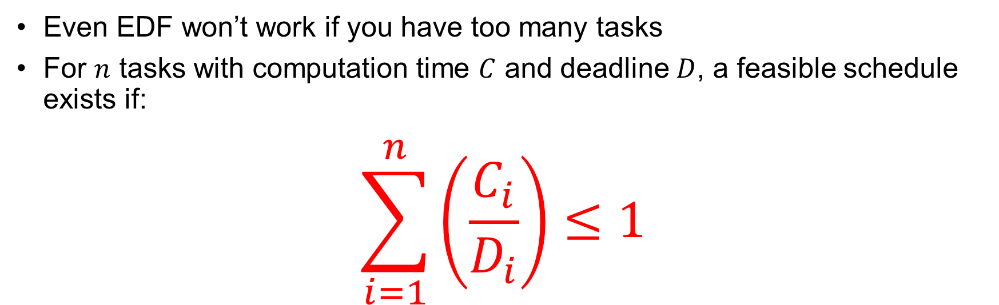
EDF Feasibility Testing
Even EDF won’t work if you have too many tasks
For $n$ tasks with computation time $C$ and deadline $D$, a feasible schedule exists if:
$$\sum_{i=1}^{n}{\left(\frac{C_{i}}{D_{i}}\right)}≤1$$

Slide 22
Ensuring Progress
Starvation: thread fails to make progress for an indefinite period of time
Starvation ≠ Deadlock because starvation could resolve under right circumstances
  Deadlocks are unresolvable, cyclic requests for resources
Causes of starvation:
  Scheduling policy never runs a particular thread on the CPU
  Threads wait for each other or are spinning in a way that will never be resolved
Let’s explore what sorts of problems we might encounter and how to avoid them…

Slide 23
Strawman: Non-Work-Conserving Scheduler
A work-conserving scheduler is one that does not leave the CPU idle when there is work to do
A non-work-conserving scheduler could trivially lead to starvation
In this class, we’ll assume that the scheduler is work-conserving (unless stated otherwise)

Slide 24
Strawman: Last-Come, First-Served (LCFS)
Stack (LIFO) as a scheduling data structure
  Late arrivals get fast service
  Early ones wait – extremely unfair
  In the worst case – starvation
When would this occur?
  When arrival rate (offered load) exceeds service rate (delivered load)
  Queue builds up faster than it drains
Queue can build in FIFO too, but “serviced in the order received”…

Slide 25
Is FCFS Prone to Starvation?
Scheduled Task (process, thread)
time
Scheduling Queue
arrivals
If a task never yields (e.g., goes into an infinite loop), then other tasks don’t get to run
Problem with all non-preemptive schedulers…
  And early personal OSes such as original MacOS, Windows 3.1, etc

Slide 26
Is Round Robin (RR) Prone to Starvation?
Each of N processes gets ~1/N of CPU (in window)
  With quantum length Q ms, process waits at most (N-1)*Q ms to run again
  So a process can’t be kept waiting indefinitely
So RR is fair in terms of waiting time
  Not necessarily in terms of throughput… (if you give up your time slot early, you don’t get the time back!)

Slide 27
Is Priority Scheduling Prone to Starvation?
Recall: Priority Scheduler always runs the
thread with highest priority
  Low priority thread might never run!
  Starvation…
But there are more serious problems as well…
  Priority inversion: even high priority threads might become starved
Priority 3
Job 1
Job 2
Job 3
Priority 2
Job 4
Priority 1
Priority 0
Job 5
Job 6
Job 7

Slide 28

Priority Inversion
Priority 3
Job 3
Priority 2
Job 2
Priority 1
Job 1
Acquire()
At this point, which job does the scheduler choose?
Job 3 (Highest priority)

Slide 29
Priority Inversion
Priority 3
Job 3
Acquire()
Priority 2
Job 2
Priority 1
Job 1
Job 3 attempts to acquire lock held by Job 1

Slide 30
Priority Inversion
Job 3
Blocked on Acquire
Priority 3
Priority 2
Job 2
Priority 1
Job 1
At this point, which job does the scheduler choose?
Job 2 (Medium Priority)
Priority Inversion

Slide 31
Priority Inversion
Where high priority task is blocked waiting on low priority task
Low priority one must run for high priority to make progress
Medium priority task can starve a high priority one
When else might priority lead to starvation or “live lock”?
High Priority
Low Priority
while (try_lock) {
…
}
lock.acquire(…)
…
lock.release(…)

Slide 32
One Solution: Priority Donation/Inheritance
Priority 3
Job 3
Acquire()
Priority 2
Job 2
Priority 1
Job 1
Job 3 temporarily grants Job 1 its “high priority” to run on its behalf

Slide 33
One Solution: Priority Donation/Inheritance
Job 3
Blocked on Acquire
Priority 3
Job 1
Release()
Priority 2
Job 2
Priority 1
Job 3 temporarily grants Job 1 its “high priority” to run on its behalf

Slide 34
One Solution: Priority Donation/Inheritance
Priority 3
Job 3
Acquire()
Priority 2
Job 2
Priority 1
Job 1
Project 2: Scheduling
Job 1 completes critical section and releases lock
Job 3 acquires lock, runs again
How does the scheduler know?

Slide 35

Case Study: Martian Pathfinder Rover
July 4, 1997 – Pathfinder lands on Mars
  First US Mars landing since Vikings in 1976; first rover
  Novel delivery mechanism: inside air-filled balloons
  bounced to stop on the surface from orbit!
And then…a few days into mission…:
  Multiple system resets occur to realtime OS (VxWorks)
  System would reboot randomly, losing valuable time and progress
Problem? Priority Inversion!
  Low priority task grabs mutex trying to
  communicate with high priority task:
  Realtime watchdog detected lack of forward progress and invoked reset to safe state
    High-priority data distribution task was supposed to complete with regular deadline
Solution: Turn priority donation back on and upload fixes!
Original developers turned off priority donation (also called priority inheritance)
  Worried about performance costs of donating priority!
Priority 2
Data Distribution Task: needs lock
Priority 1
Lots of random medium stuff
Priority 0
ASI/MET collector: grab lock

Slide 36
Are SRTF and MLFQ Prone to Starvation?
Long-Running Compute
Tasks Demoted to
Low Priority
In SRTF, long jobs are starved in favor of short ones
  Same fundamental problem as priority scheduling
MLFQ is an approximation of SRTF, so it suffers from the same problem

Slide 37
Cause for Starvation: Priorities?
The policies we’ve studied so far:
  Always prefer to give the CPU to a prioritized job
  Non-prioritized jobs may never get to run
But priorities were a means, not an end
Our end goal was to serve a mix of CPU-bound, I/O bound, and Interactive jobs effectively on common hardware
  Give the I/O bound ones enough CPU to issue their next file operation and wait (on those slow discs)
  Give the interactive ones enough CPU to respond to an input and wait (on those slow humans)
  Let the CPU bound ones grind away without too much disturbance

Slide 38
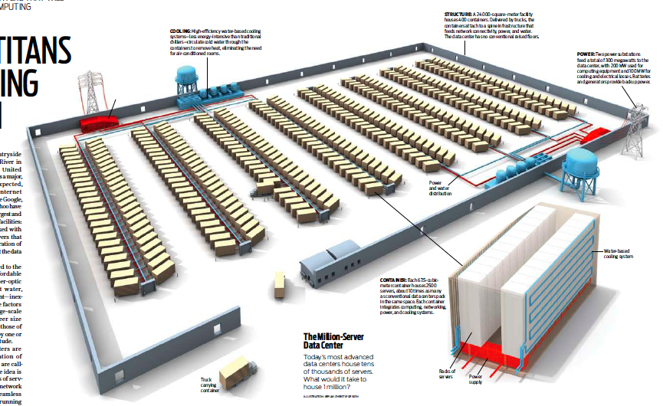
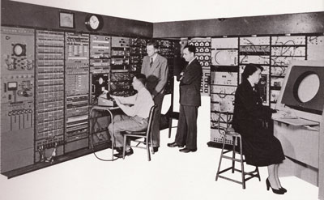
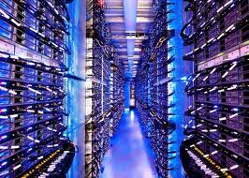
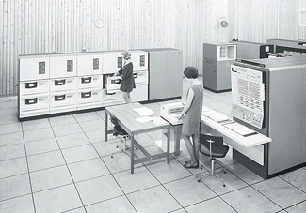
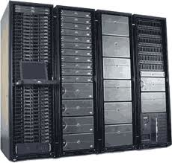
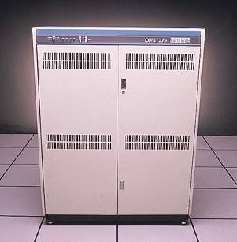
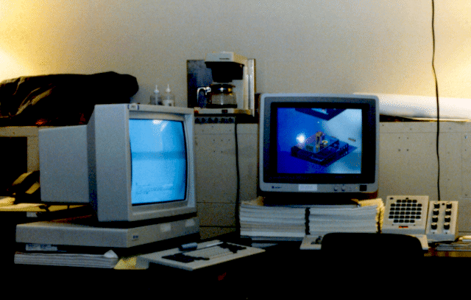

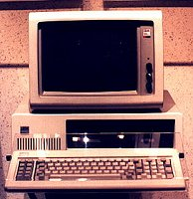





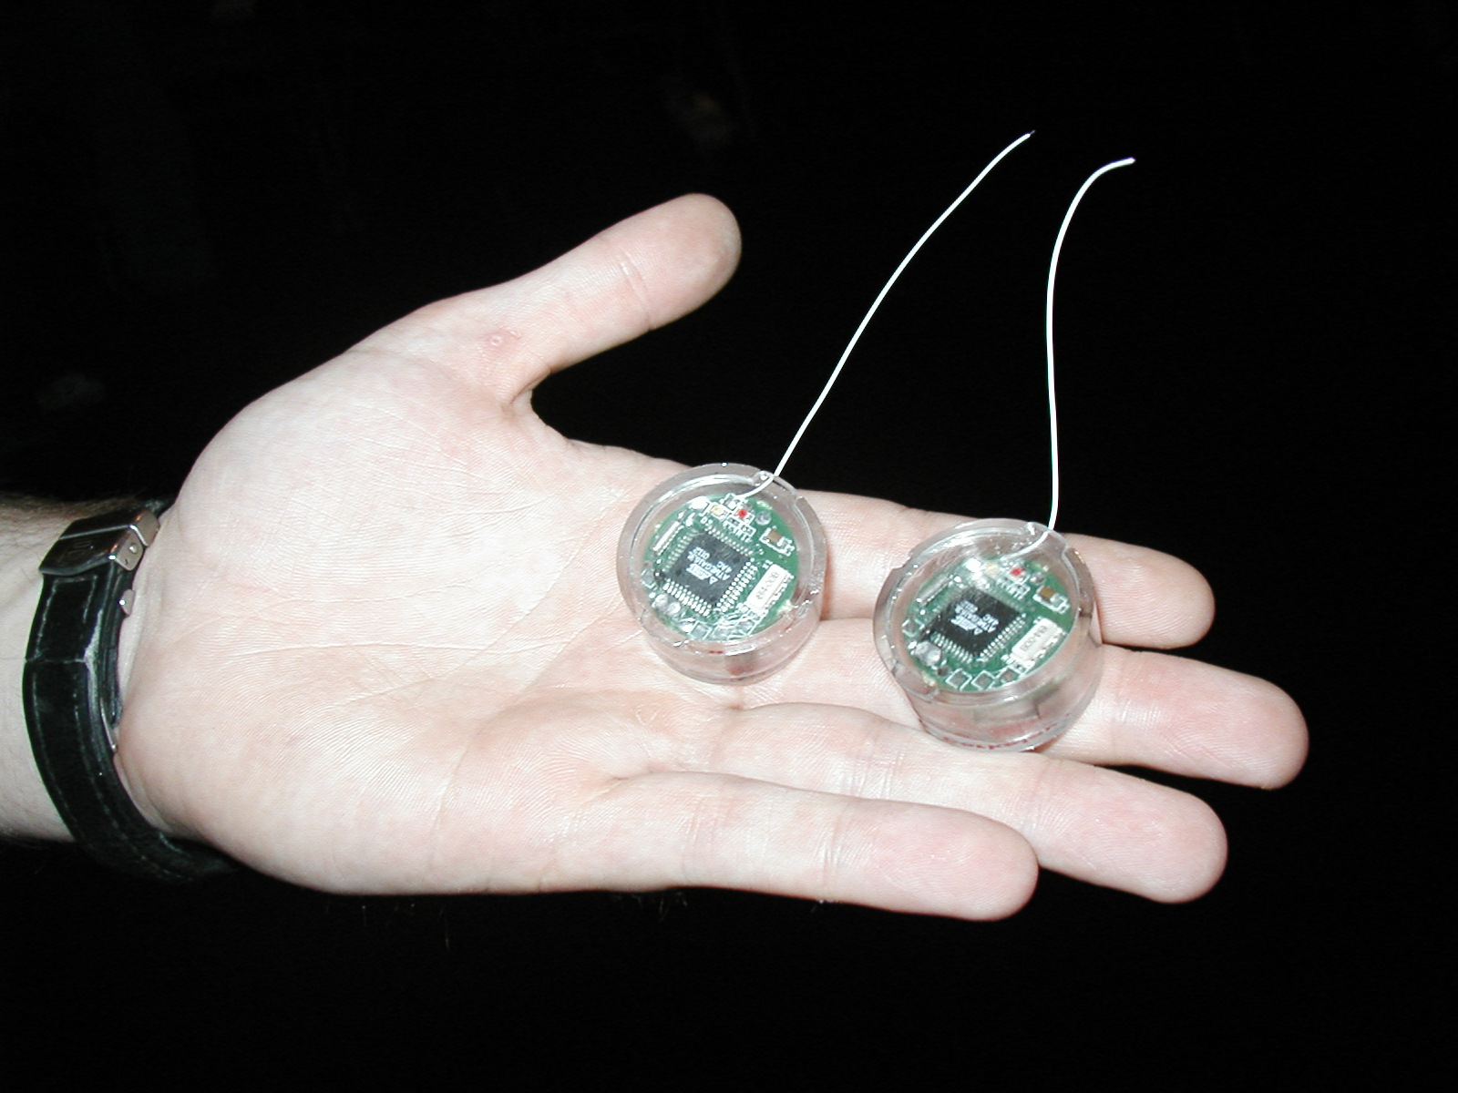
Recall: Changing Landscape…
Computers
Per Person
Number crunching, Data Storage, Massive Inet Services,
ML, …
1:10⁶
Mainframe
Bell’s Law: New computer class every 10 years
Mini
1:10³
Workstation
Productivity,
Interactive
PC
Laptop
1:1
PDA
Cell
Streaming from/to the physical world
10³:1
years
Mote!
The Internet of Things!

Slide 39
Changing Landscape of Scheduling
Priority-based scheduling rooted in “time-sharing”
  Allocating precious, limited resources across a diverse workload
    CPU bound, vs interactive, vs I/O bound
80’s brought about personal computers, workstations, and servers on networks
  Different machines of different types for different purposes
  Shift to fairness and avoiding extremes (starvation)
90’s emergence of the web, rise of internet-based services, the data-center-is-the-computer
  Server consolidation, massive clustered services, huge flashcrowds
  It’s about predictability, 95th percentile performance guarantees

Slide 40
Key Idea: Proportional-Share Scheduling
The policies we’ve studied so far:
  Always prefer to give the CPU to a prioritized job
  Non-prioritized jobs may never get to run
Instead, we can share the CPU proportionally
  Give each job a share of the CPU according to its priority
  Low-priority jobs get to run less often
  But all jobs can at least make progress (no starvation)

Slide 41
Lottery Scheduling
Simple Idea:
  Give each job some number of lottery tickets
  On each time slice, randomly pick a winning ticket
  On average, CPU time is proportional to number of tickets
  given to each job
How to assign tickets?
  To approximate SRTF, short running jobs get more, long running jobs get fewer
  To avoid starvation, every job gets at least one ticket (everyone makes progress)
Advantage over strict priority scheduling: behaves gracefully as load changes
  Adding or deleting a job affects all jobs proportionally, independent of how many tickets each job possesses

Slide 42
Lottery Scheduling Example (Cont.)
Lottery Scheduling Example
  Assume short jobs get 10 tickets, long jobs get 1 ticket
  What if too many short jobs to give reasonable response time?
    If load average is 100, hard to make progress
    One approach: log some user out
# short jobs/ # long jobs | % of CPU each short jobs gets | % of CPU each long jobs gets
1/1 | 91% | 9%
0/2 | N/A | 50%
2/0 | 50% | N/A
10/1 | 9.9% | 0.99%
1/10 | 50% | 5%

Slide 43
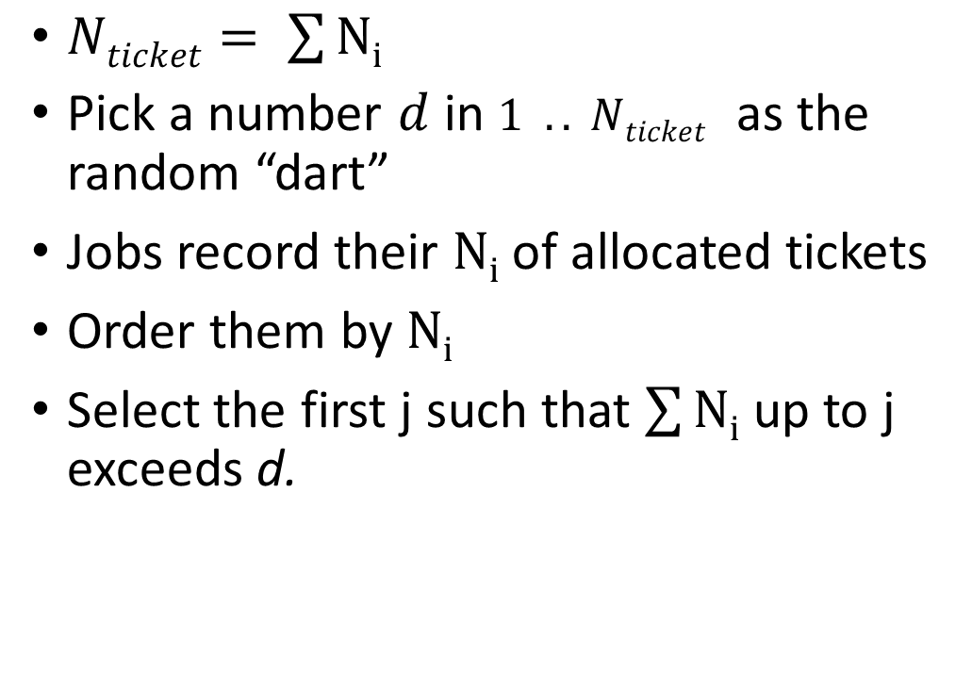
Lottery Scheduling: Simple Mechanism
10
$Nticket= \sum{Ni}$
Pick a number $d$ in $1 .. Nticket$ as the random “dart”
Jobs record their $Ni$ of allocated tickets
Order them by $Ni$
Select the first j such that $\sum{Ni}$ up to j exceeds d.
1

Slide 44
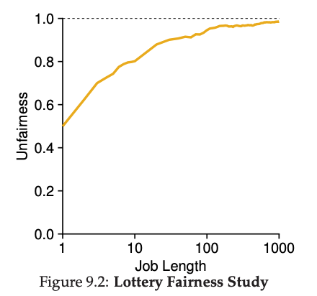
Unfairness
E.g., Given two jobs A and B of same run time (# Qs) that are each supposed to receive 50%,
U = finish time of first / finish time of last
As a function of run time

Slide 45
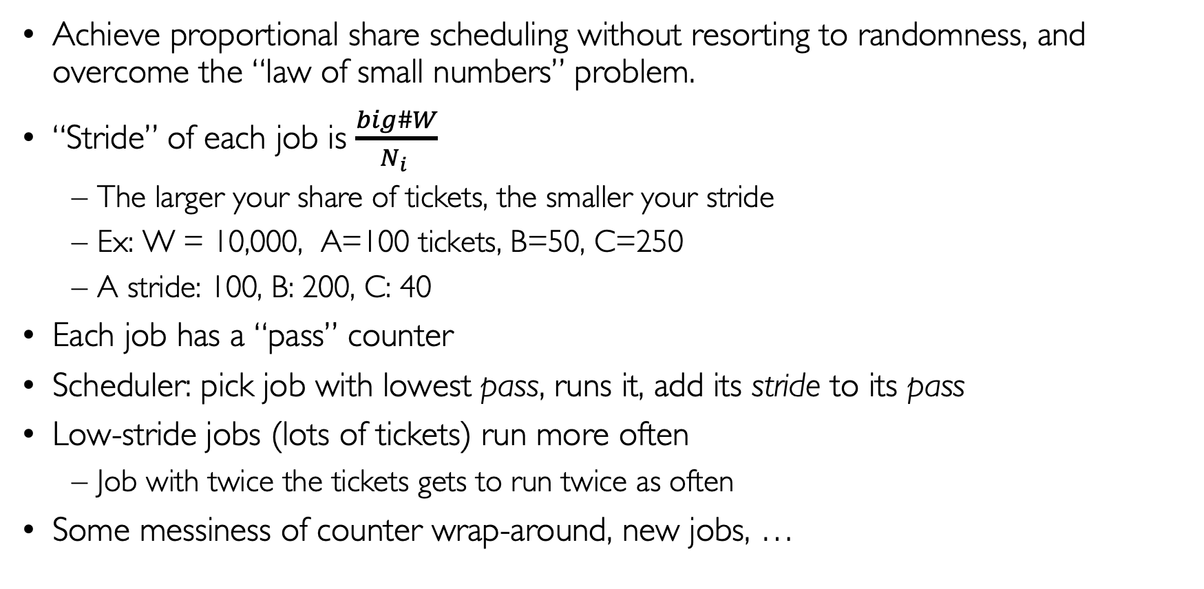
Stride Scheduling
Achieve proportional share scheduling without resorting to randomness, and overcome the “law of small numbers” problem.
“Stride” of each job is $\frac{big\#W}{N_{i} }$
  The larger your share of tickets, the smaller your stride
  Ex: W = 10,000, A=100 tickets, B=50, C=250
  A stride: 100, B: 200, C: 40
Each job has a “pass” counter
Scheduler: pick job with lowest pass, runs it, add its stride to its pass
Low-stride jobs (lots of tickets) run more often
  Job with twice the tickets gets to run twice as often
Some messiness of counter wrap-around, new jobs, …

Slide 46
Conclusion
Multi-Level Feedback Scheduling:
  Multiple queues of different priorities and scheduling algorithms
  Automatic promotion/demotion of process priority in order to approximate SJF/SRTF
Realtime Schedulers such as EDF
  Guaranteed behavior by meeting deadlines
  Realtime tasks defined by tuple of compute time and period
  Schedulability test: is it possible to meet deadlines with proposed set of processes?
Priority Inversion
  A higher-priority task is prevented from running by a lower-priority task
  Often caused by locks and through the intervention of a middle-priority task
Proportional Share Scheduling
  Give each job a share of the CPU according to its priority
  Low-priority jobs get to run less often
  But all jobs can at least make progress (no starvation)

